Slide 1

IEEE S&P
“Only as Strong as the Weakest Link”:
On the Security of Brokered Single Sign-On on the Web
Tommaso Innocenti, Louis Jannett, Christian Mainka, Vladislav Mladenov, Engin Kirda (Appearing in S&P’25)

Slide 2


Tommaso Innocenti
PhD candidate
@Northeastern University
(Boston)
innotommy.com

Slide 3



Paper summary
The Brokered SSO
The “redirect_uri” validation of IdB
The 3+1 problems of the Brokered SSO

Slide 4
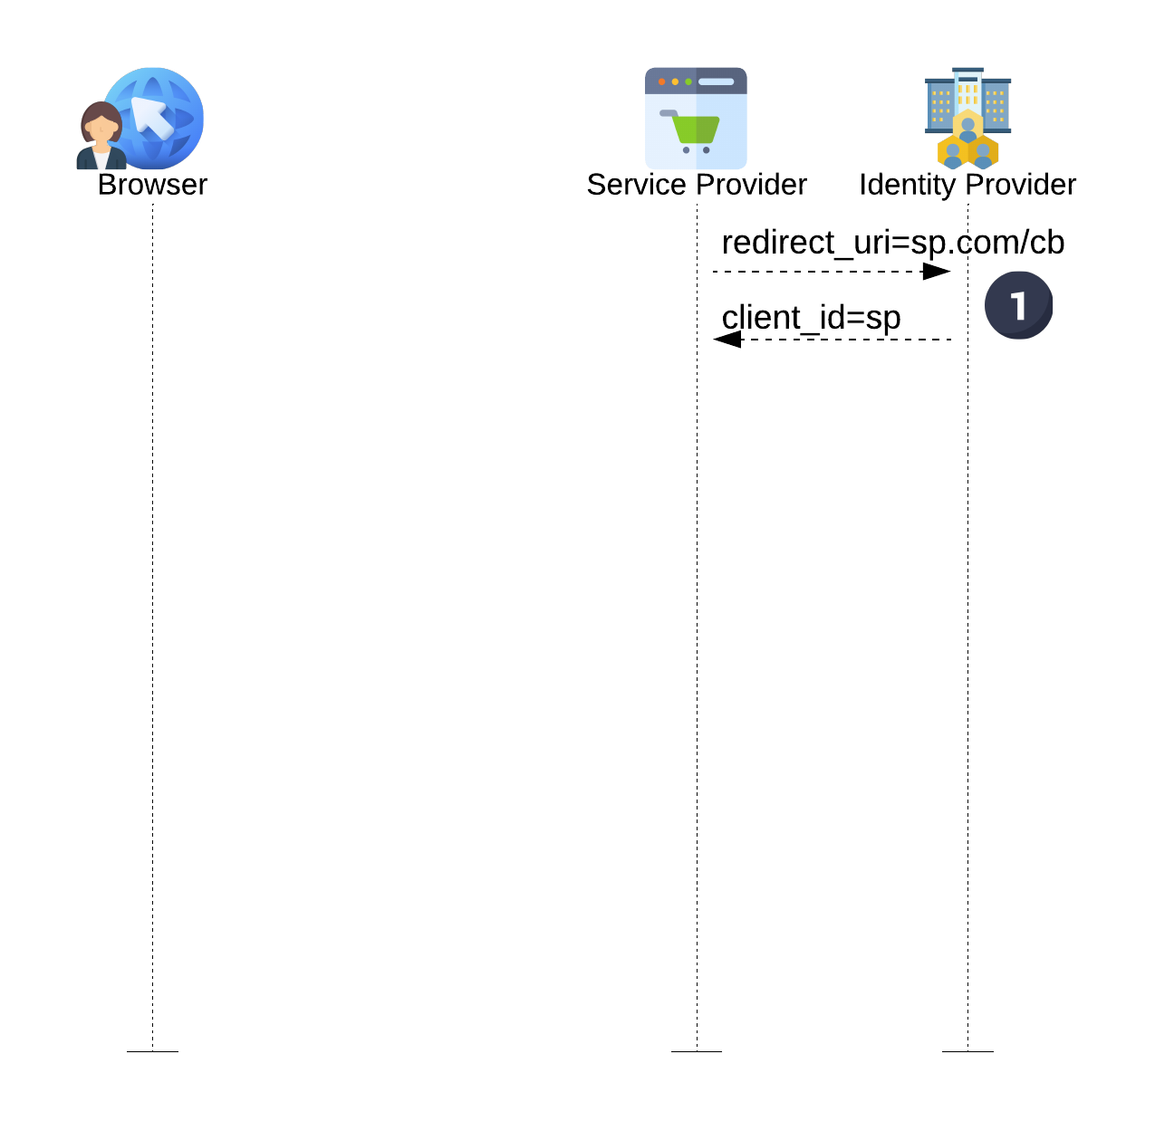
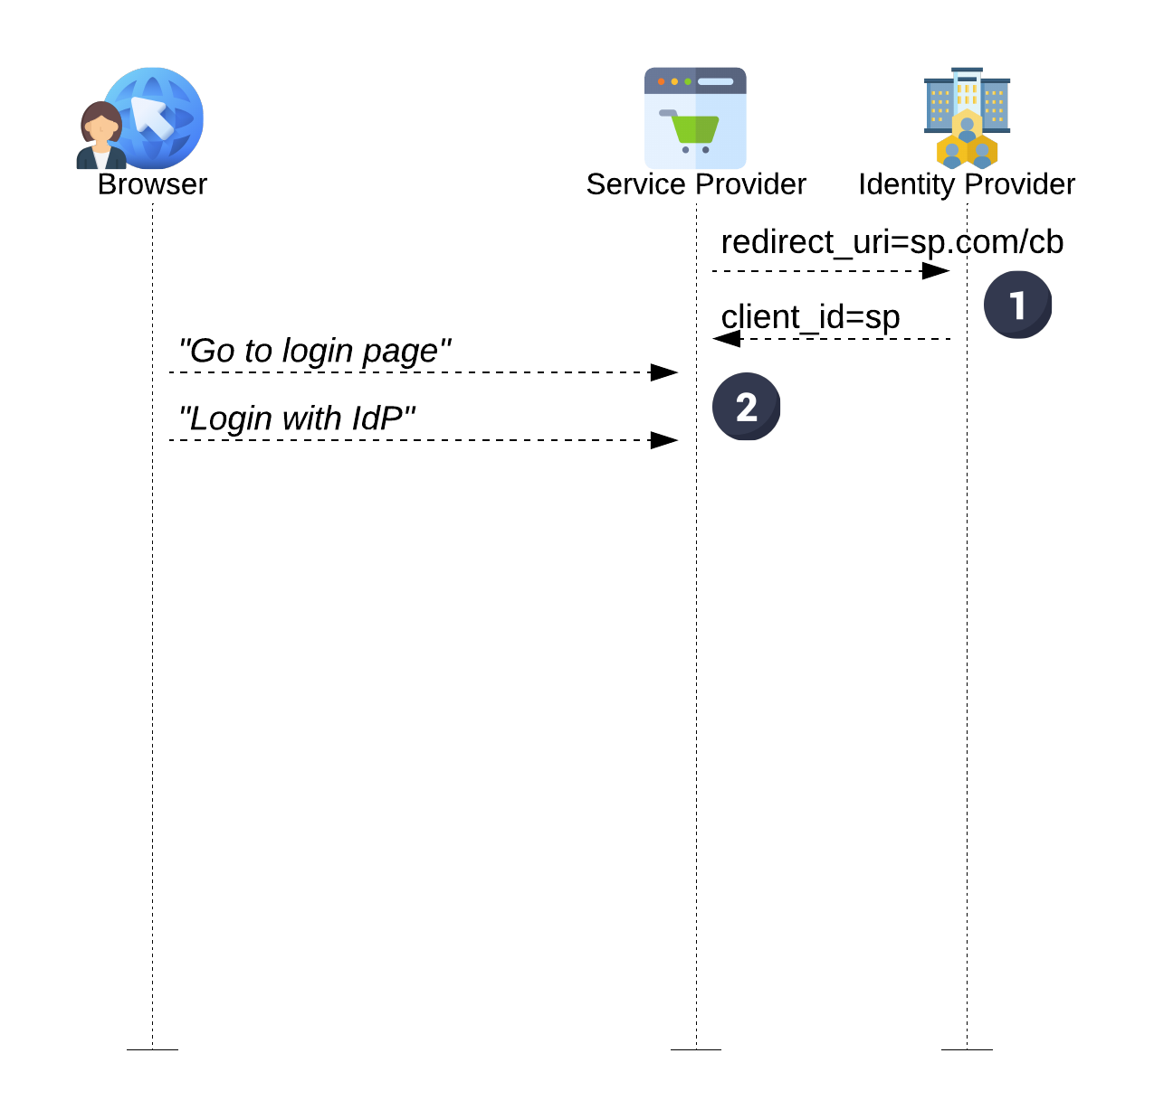
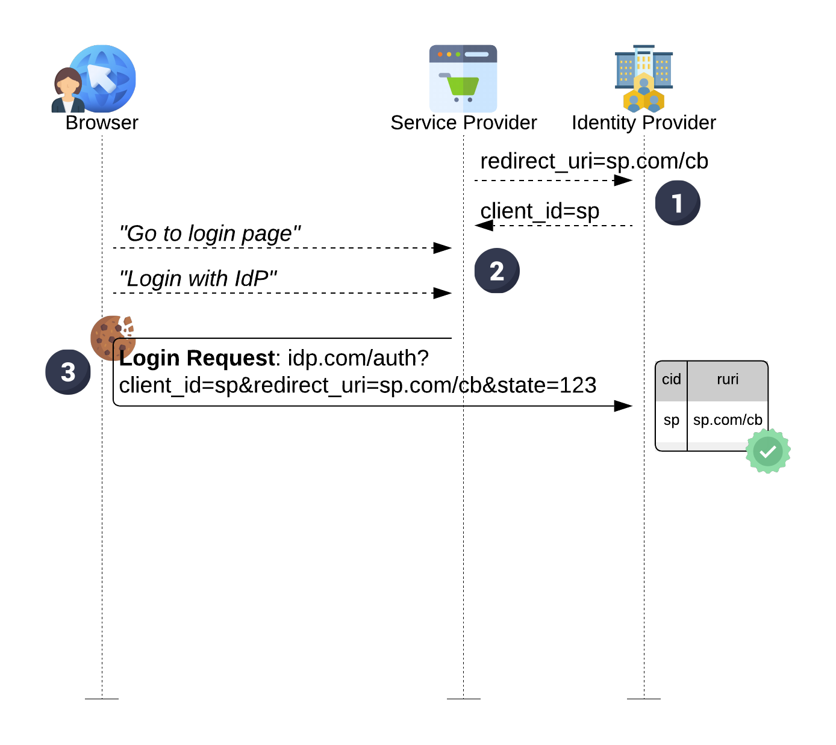
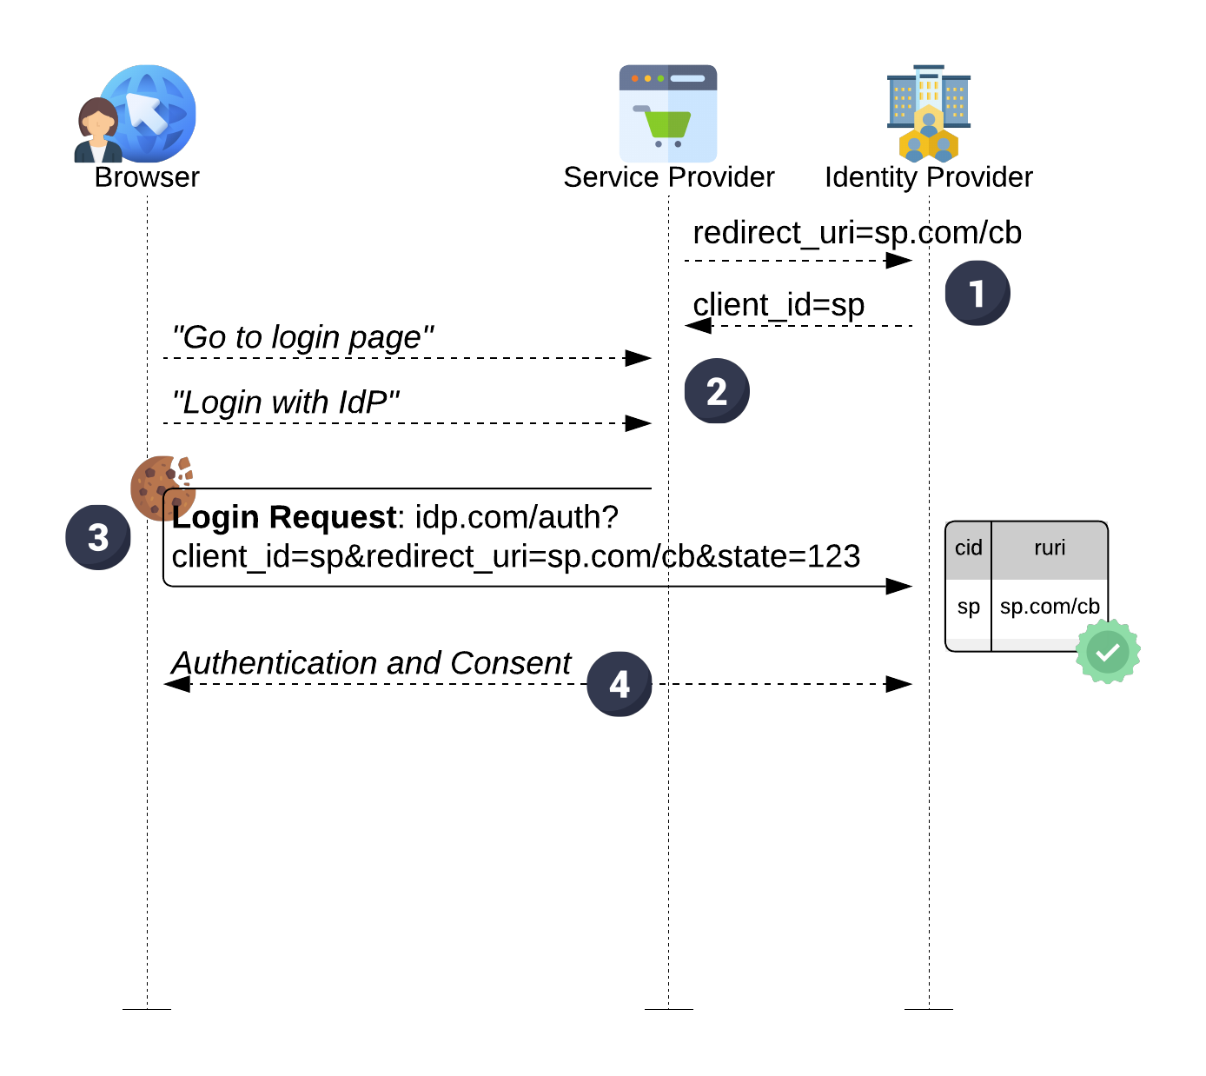
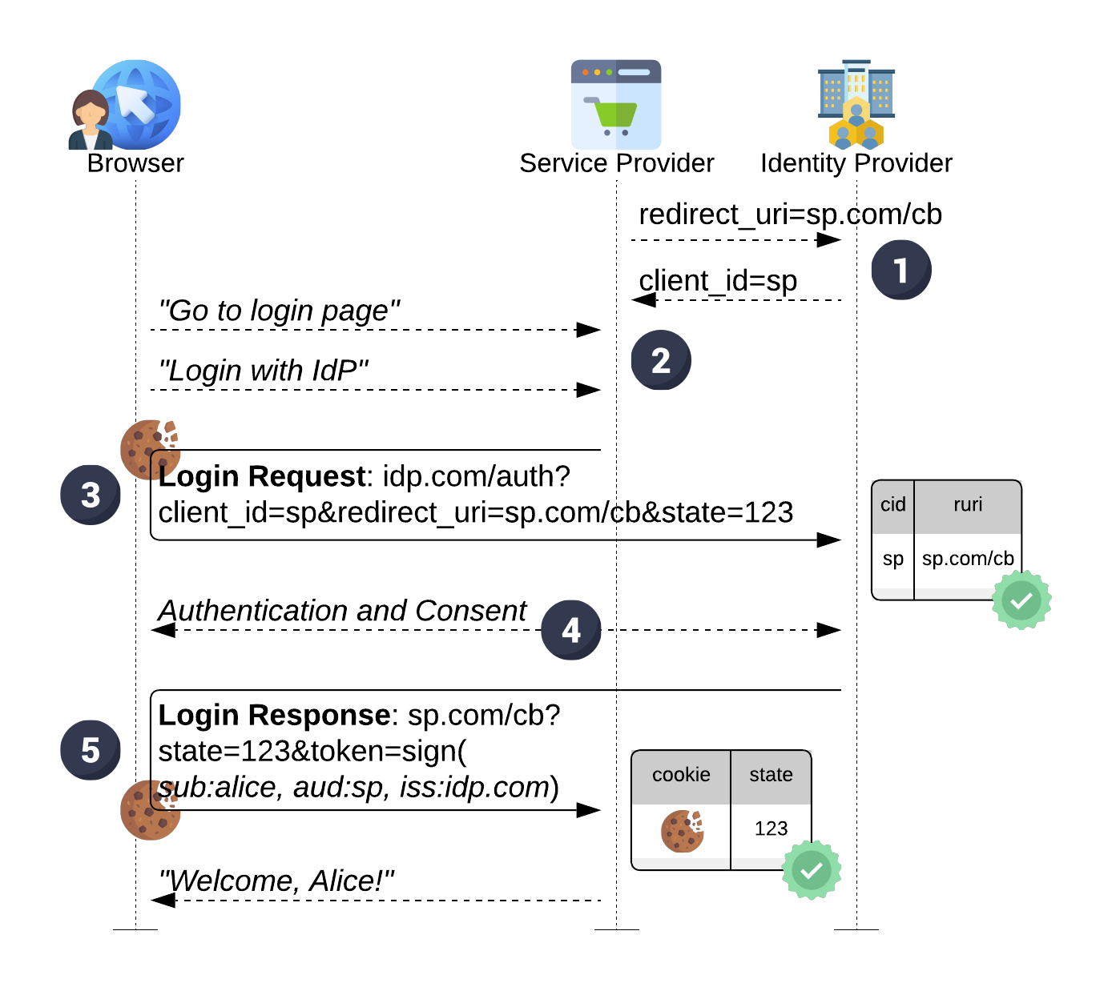
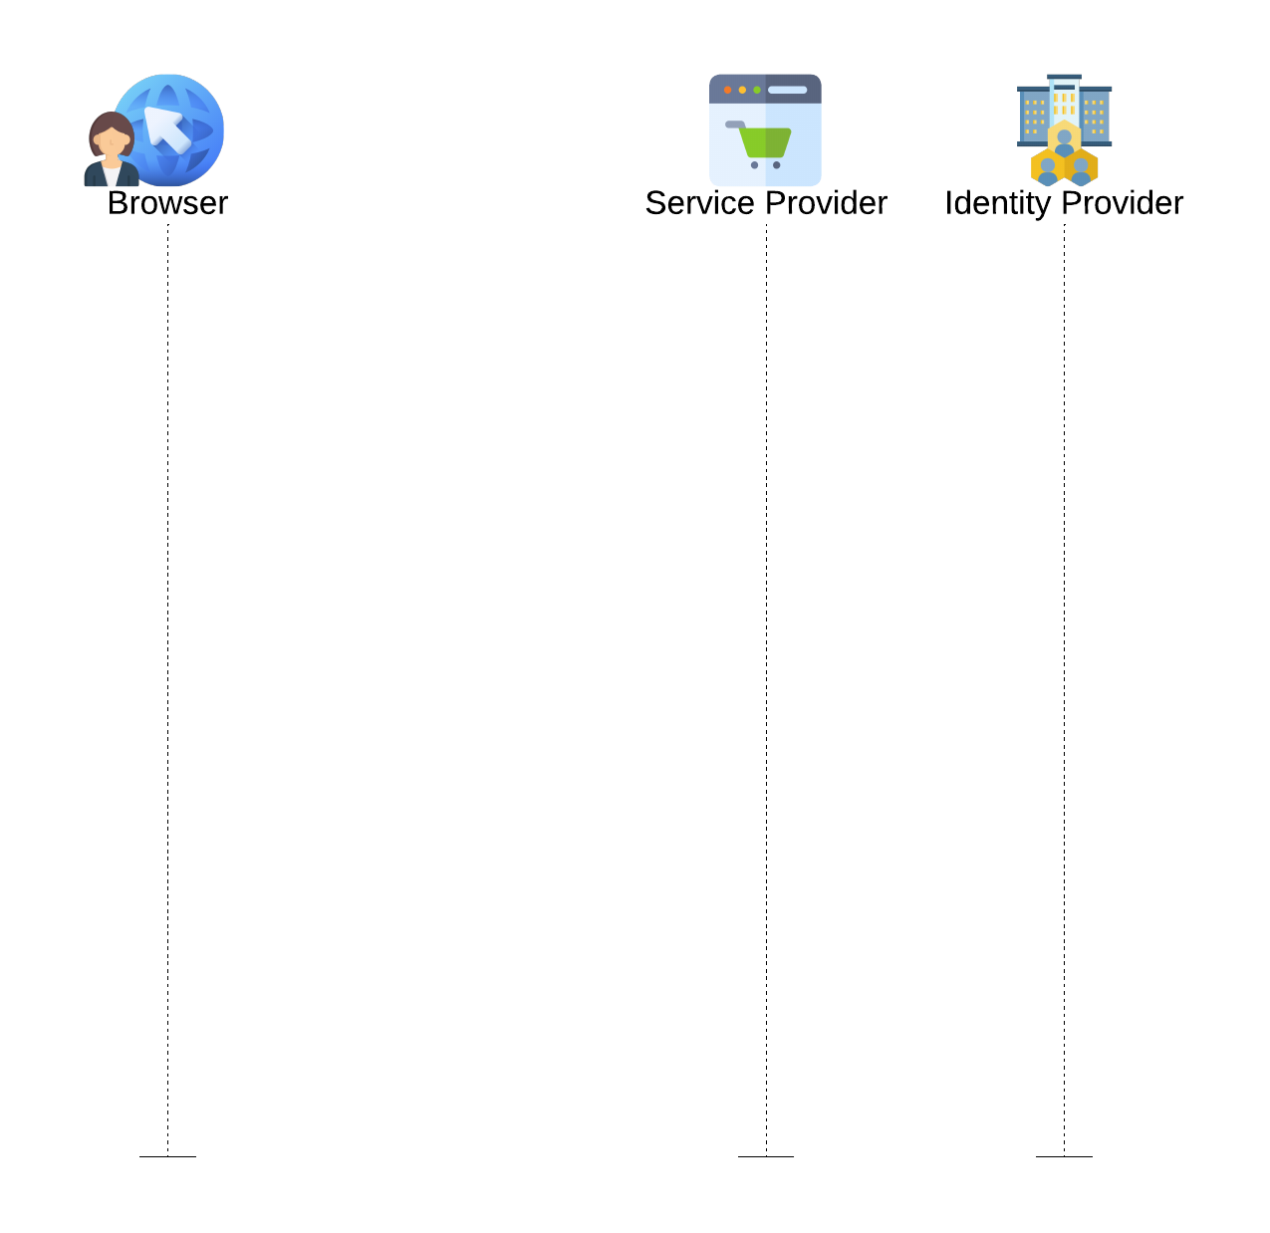






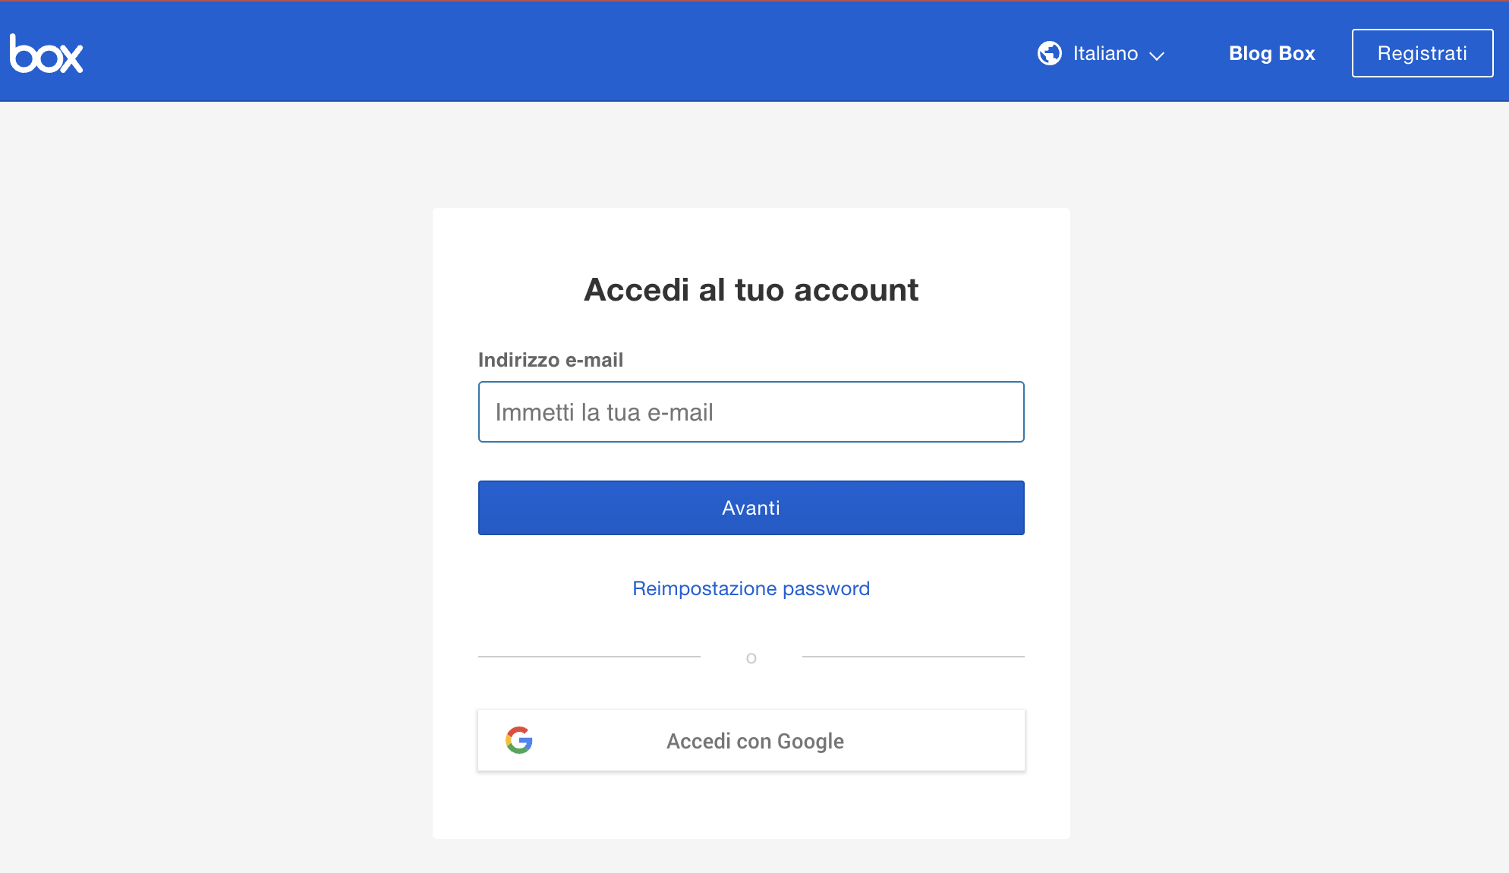
Traditional SSO Flow:
Registration phase
Login flow

Slide 5
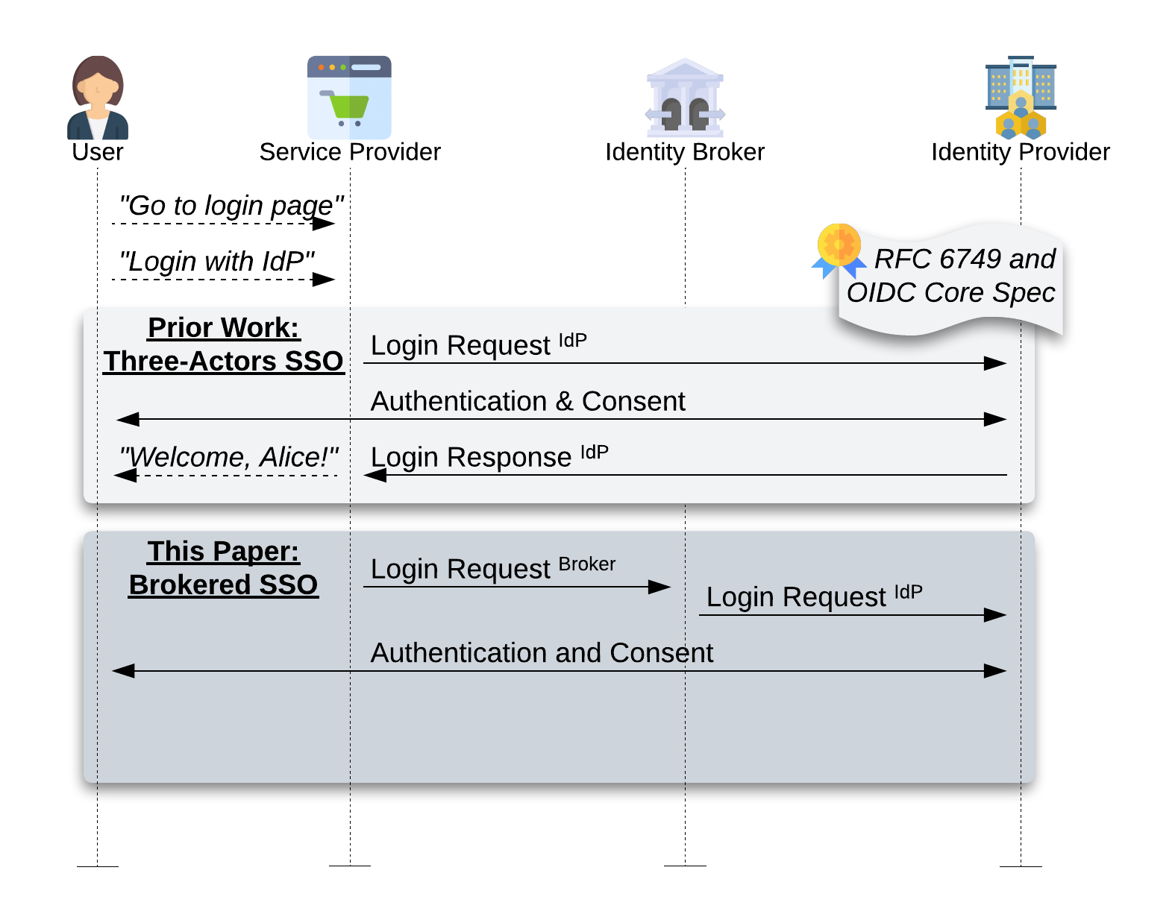

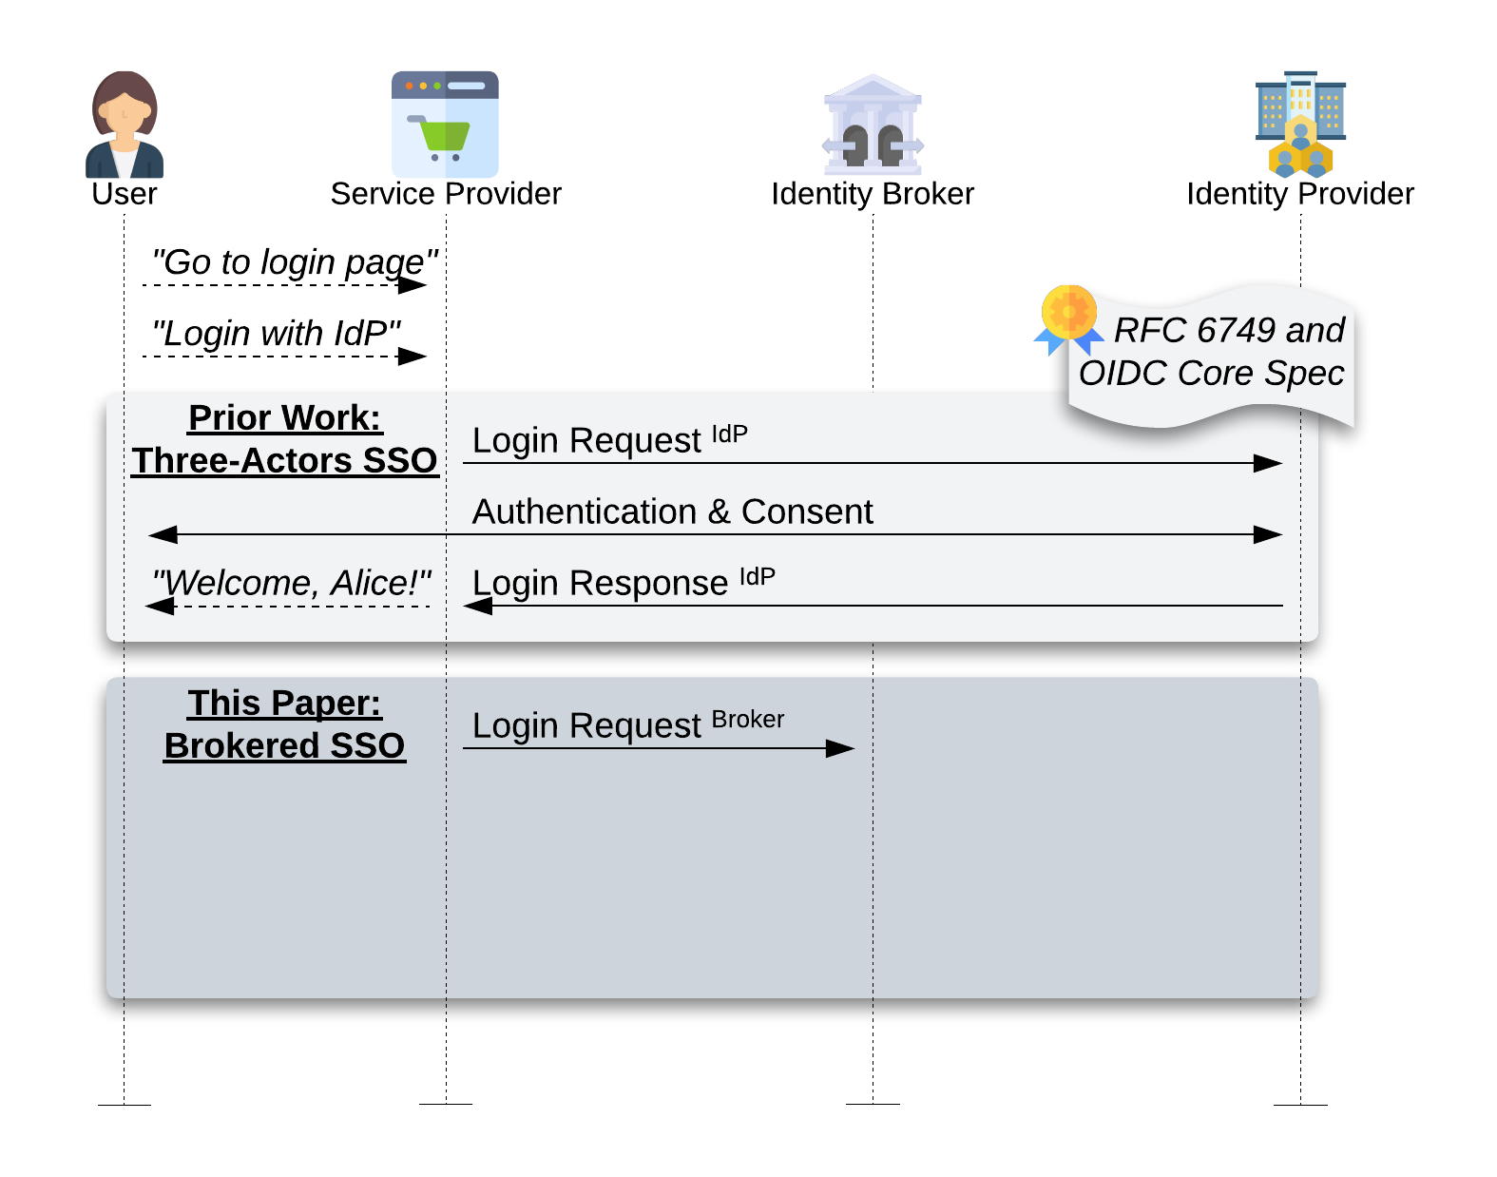





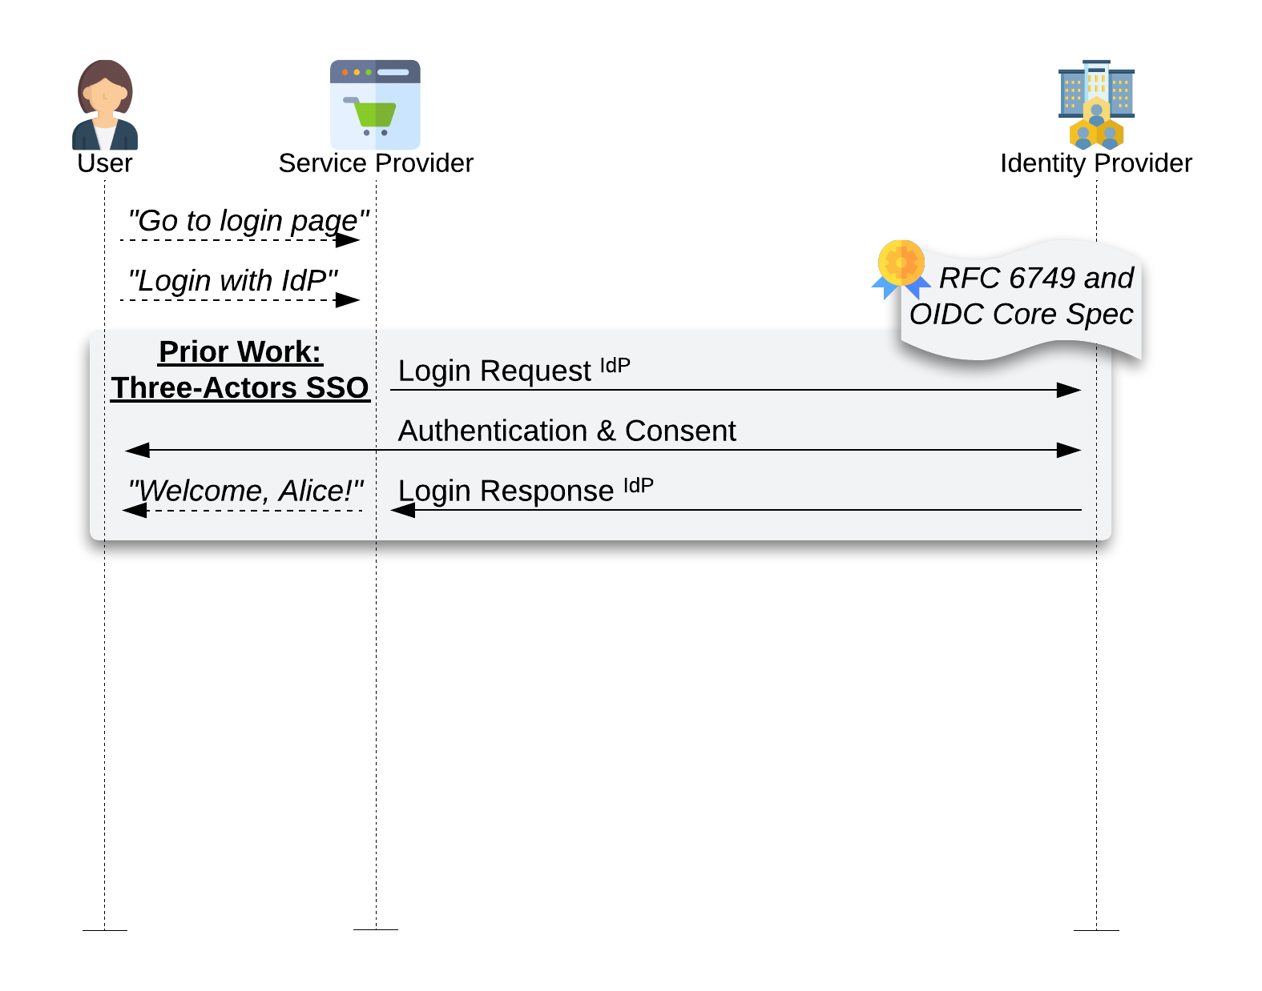
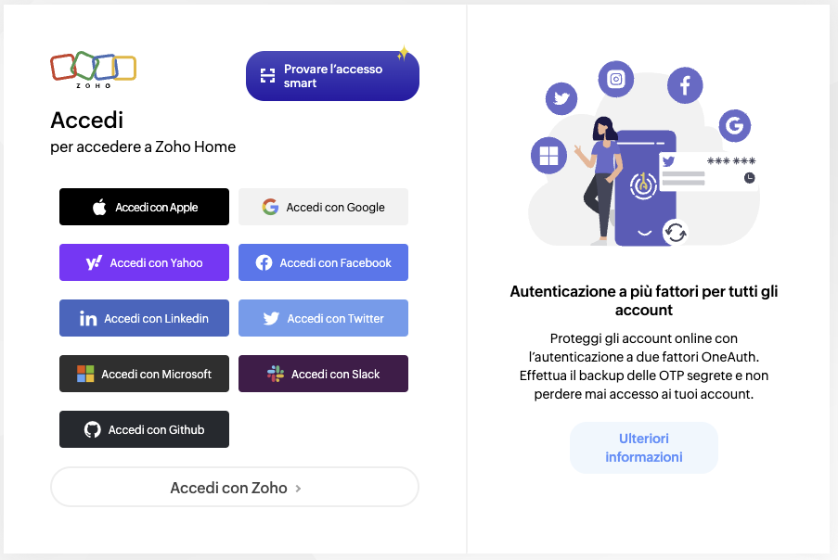
Traditional SSO Flow
vs.
Brokered SSO Flow:
Identity Brokers in the login flow

Slide 6
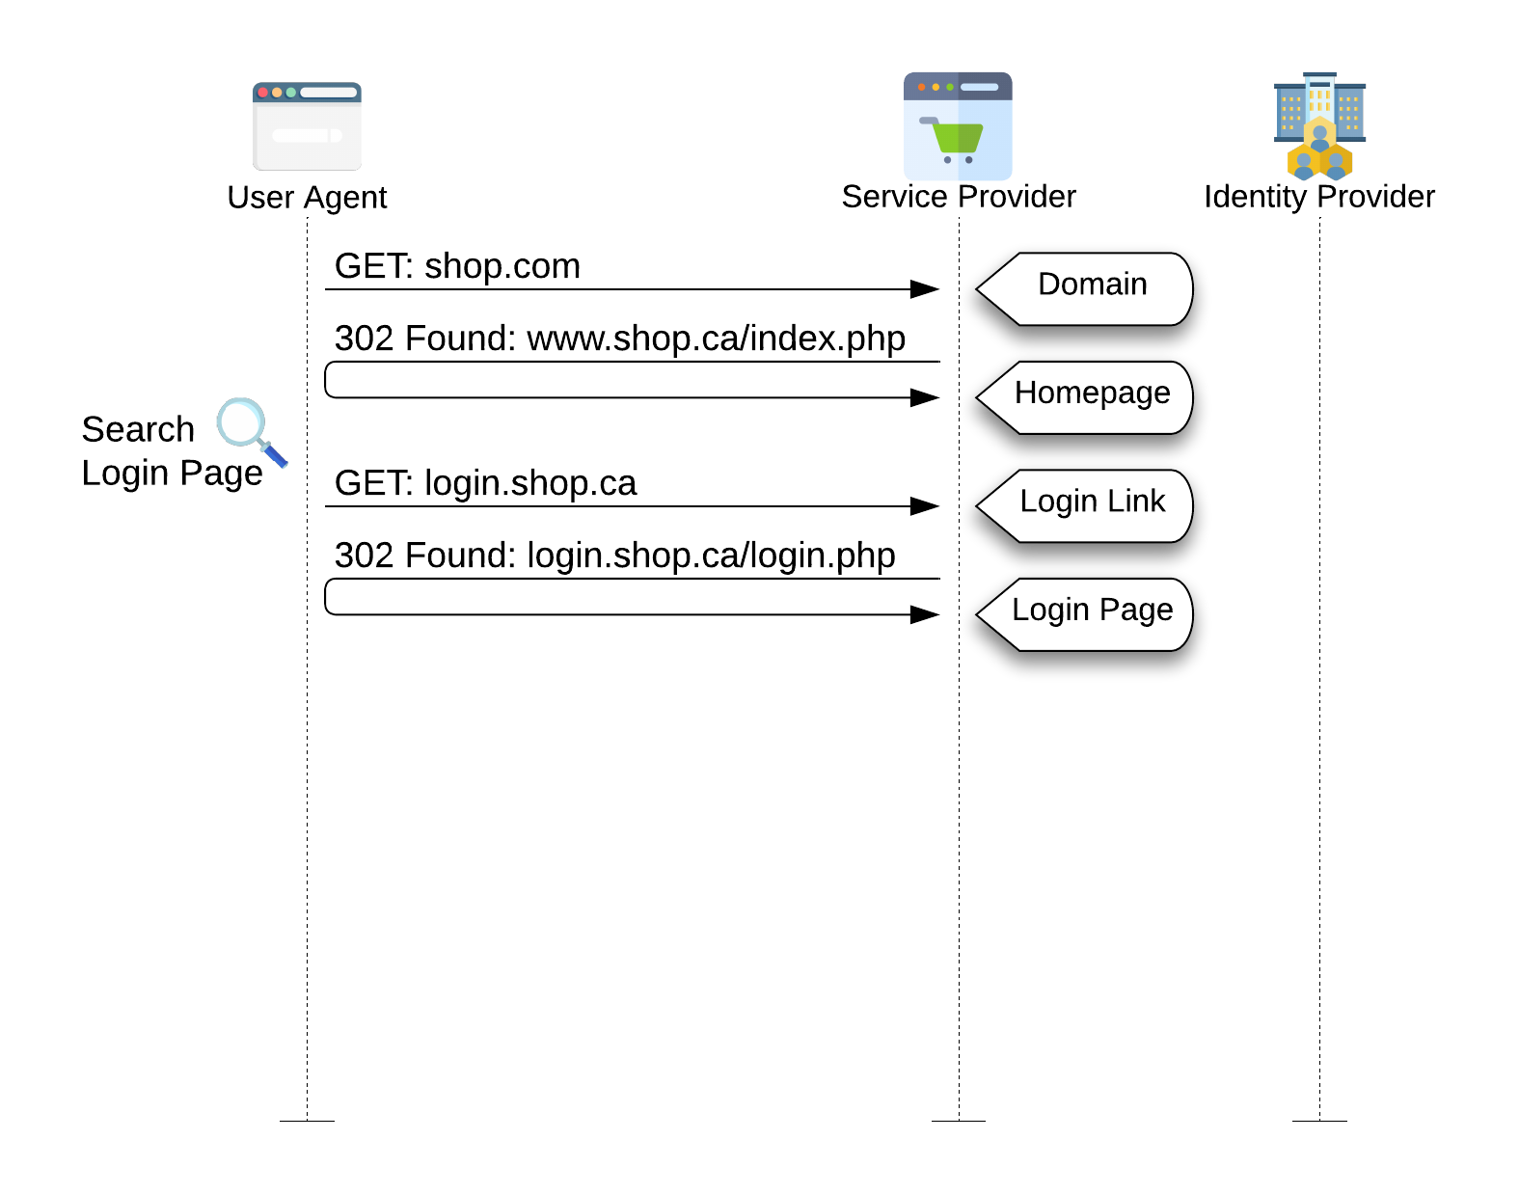
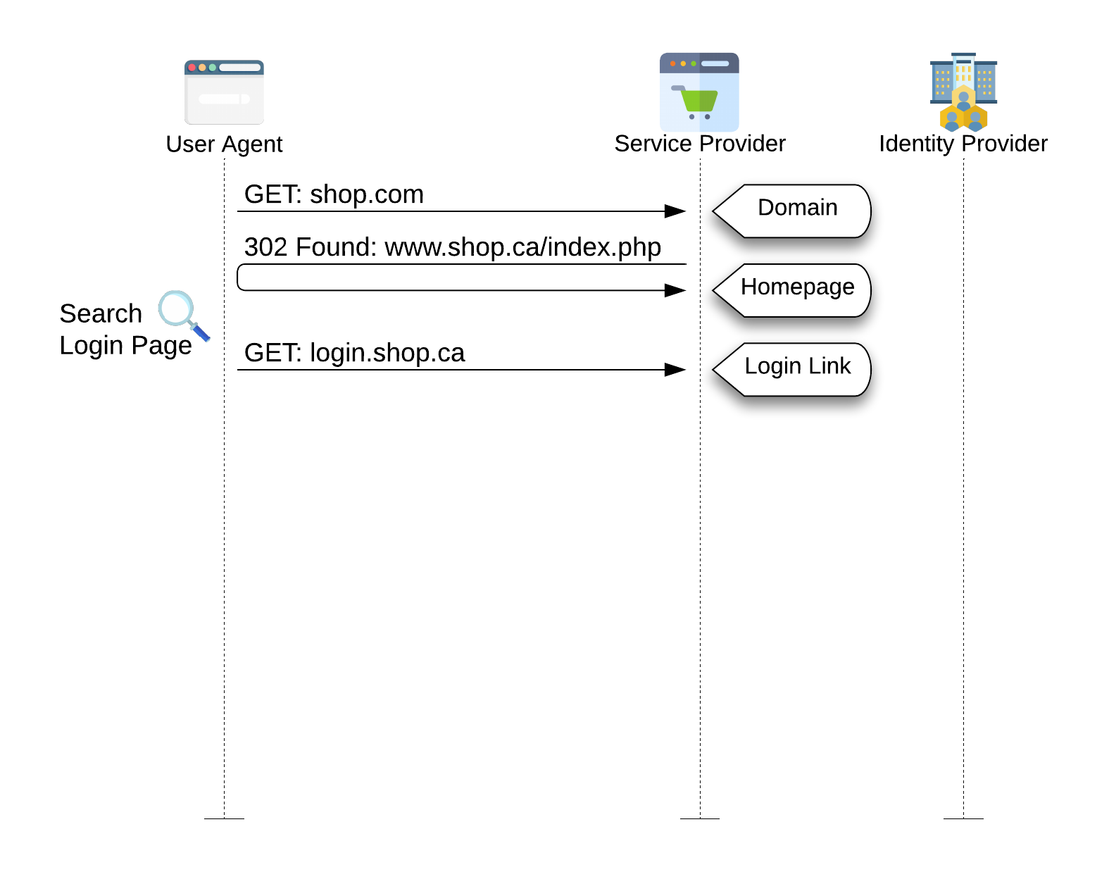
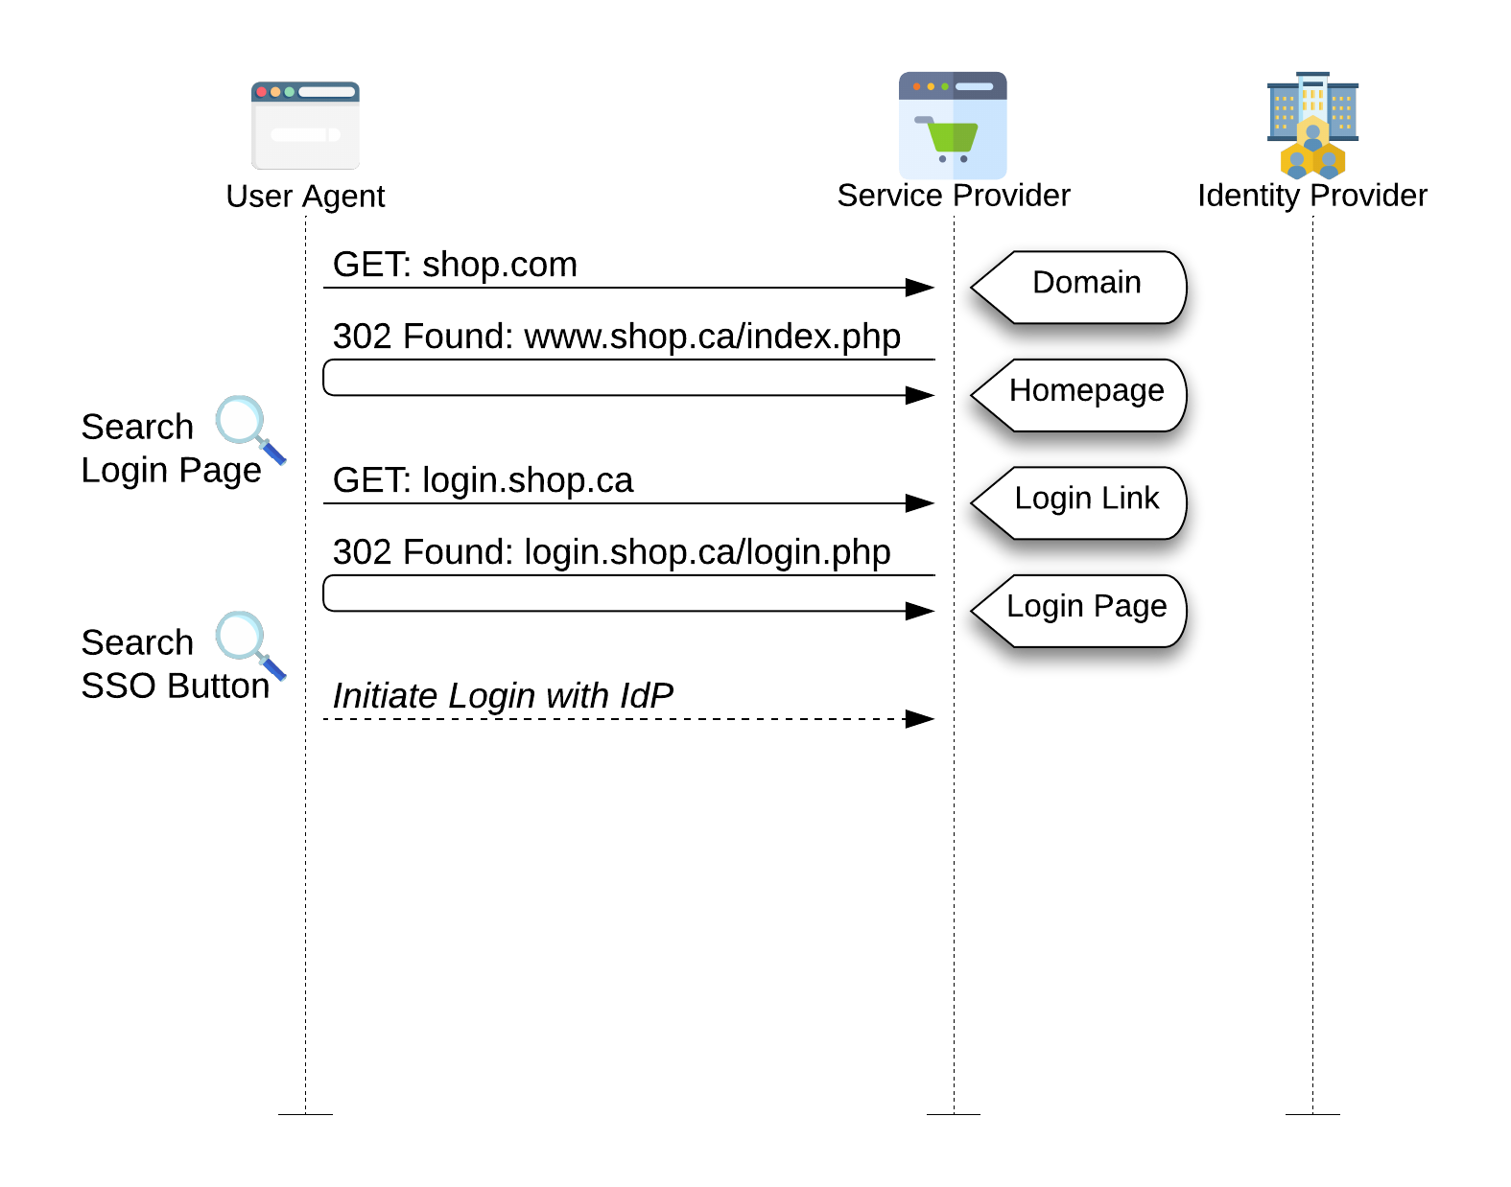
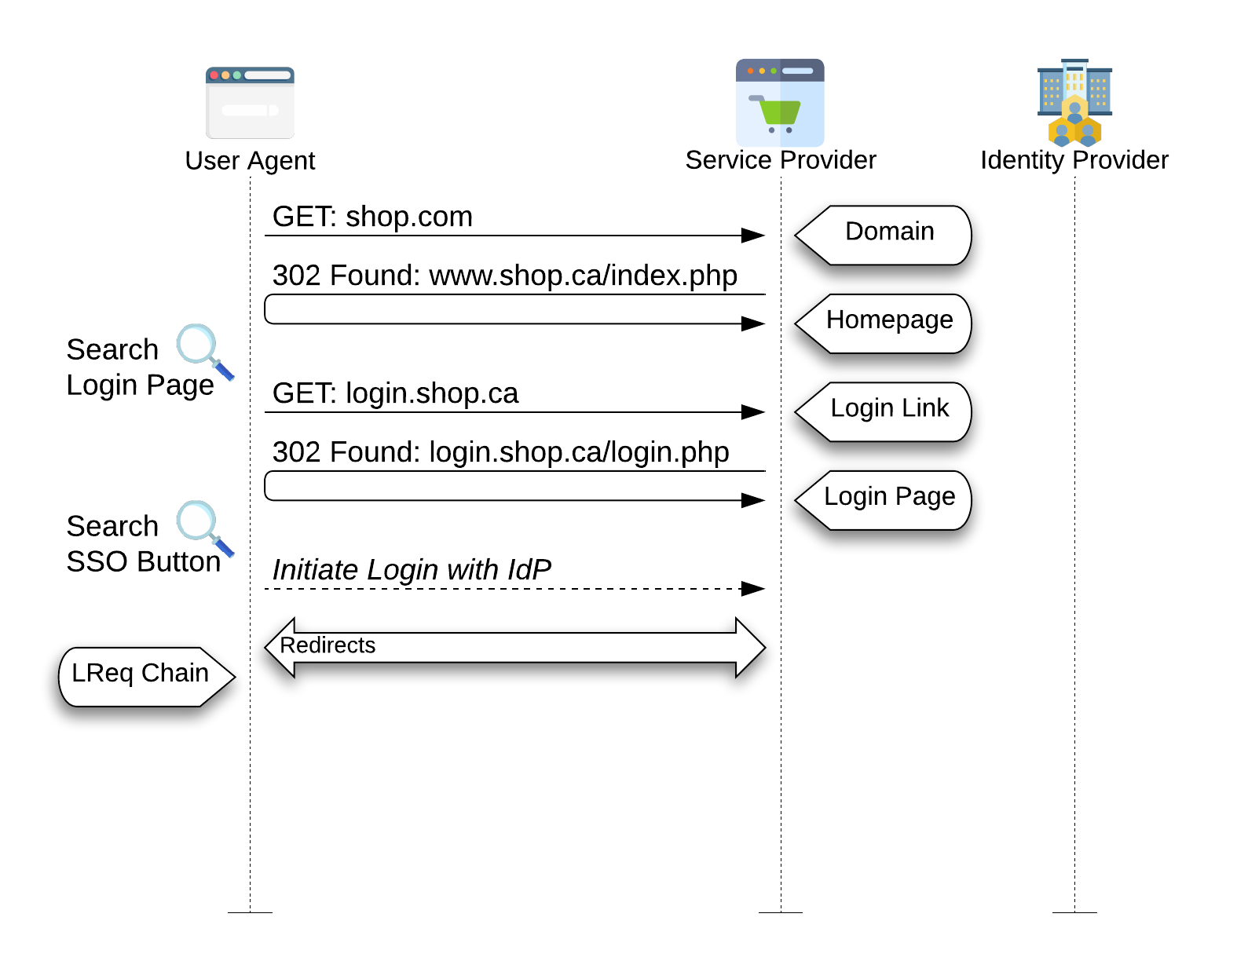
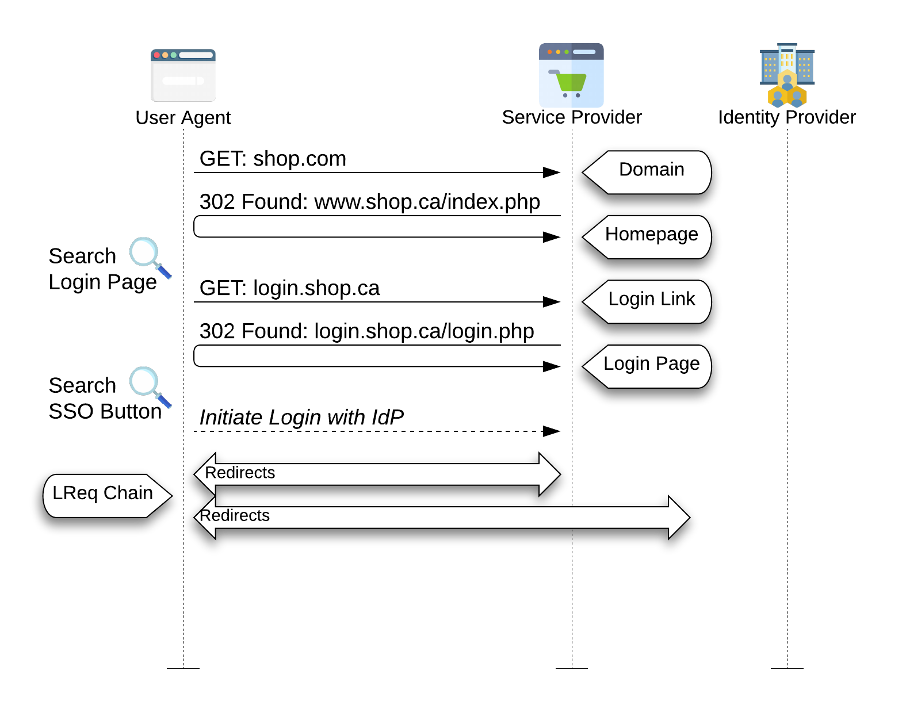
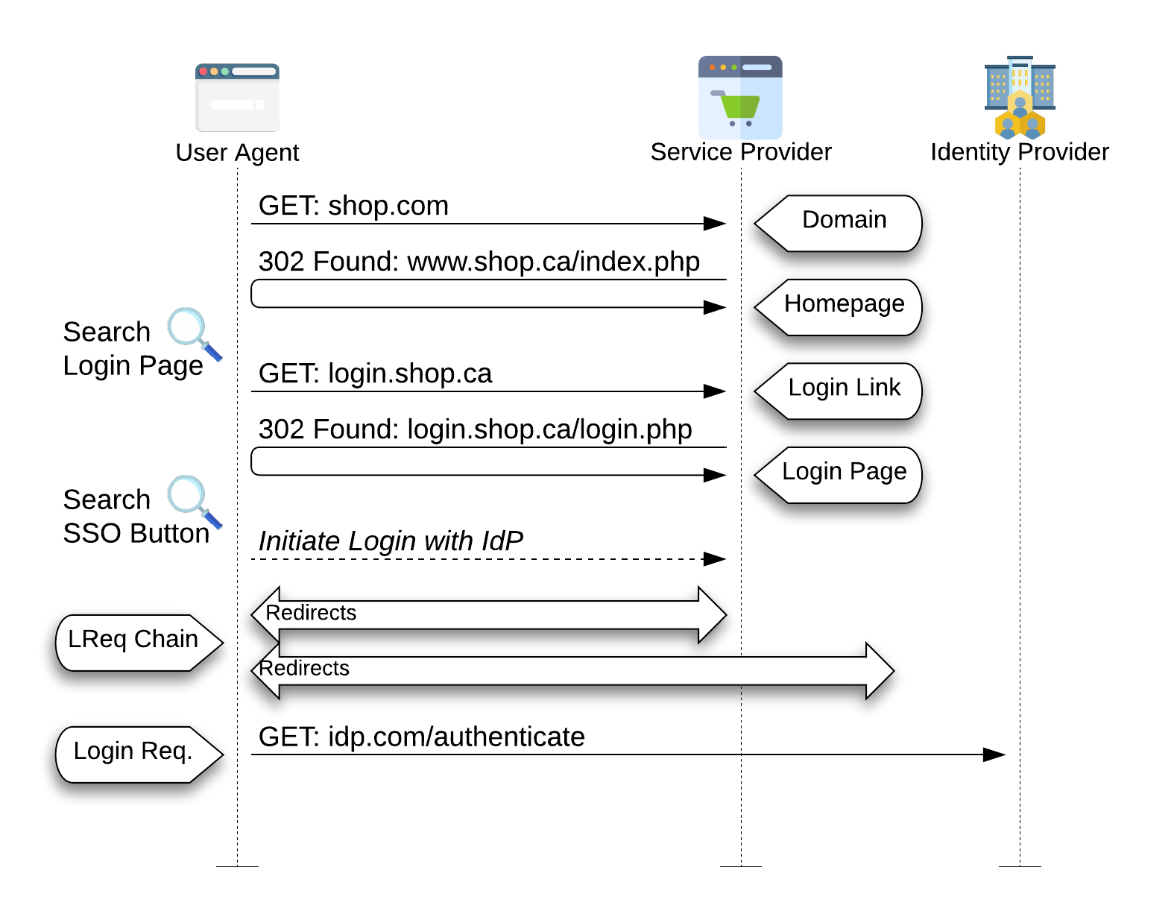
Dataset
Used Sok: SSO-Monitor_{[1]} database:
88,983 SSO flows
across the Tranco 1M websites
[1] Louis Jannett et al. “SoK: SSO-MONITOR — The Current State and Future Research Directions in Single Sign-On Security Measurements”

Slide 7
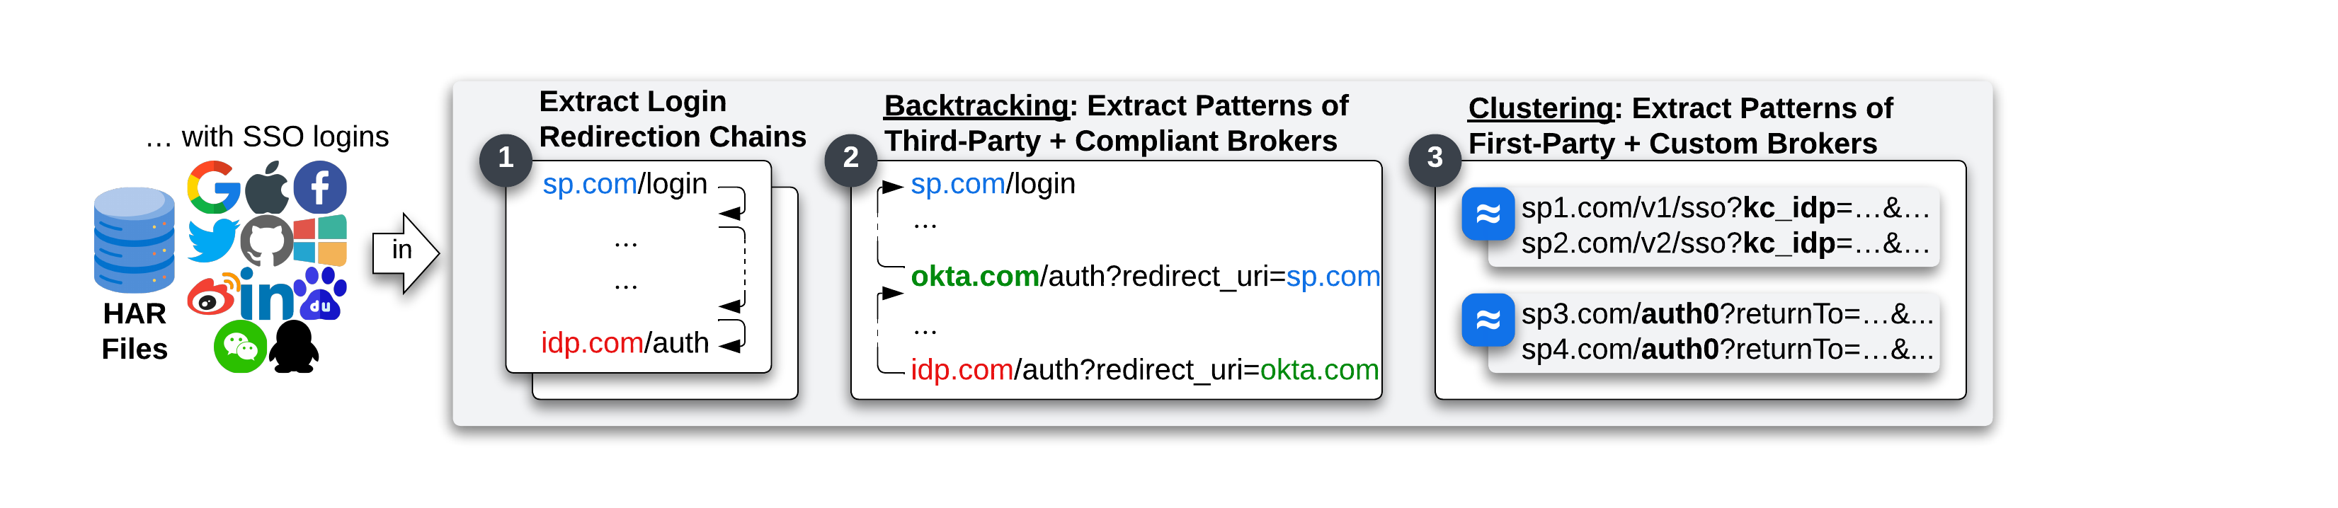
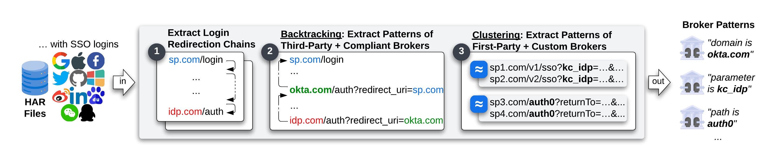
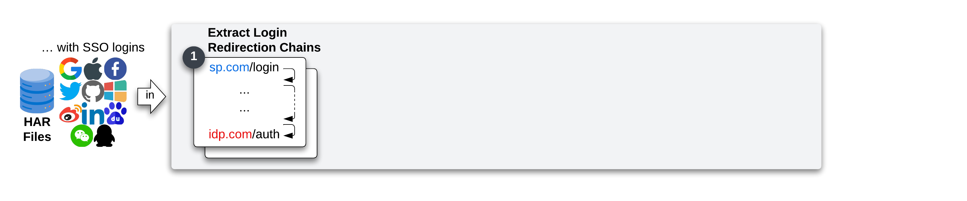
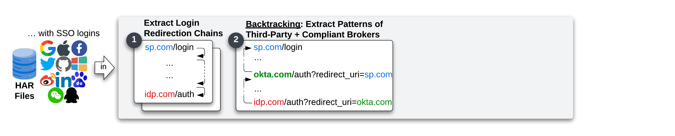
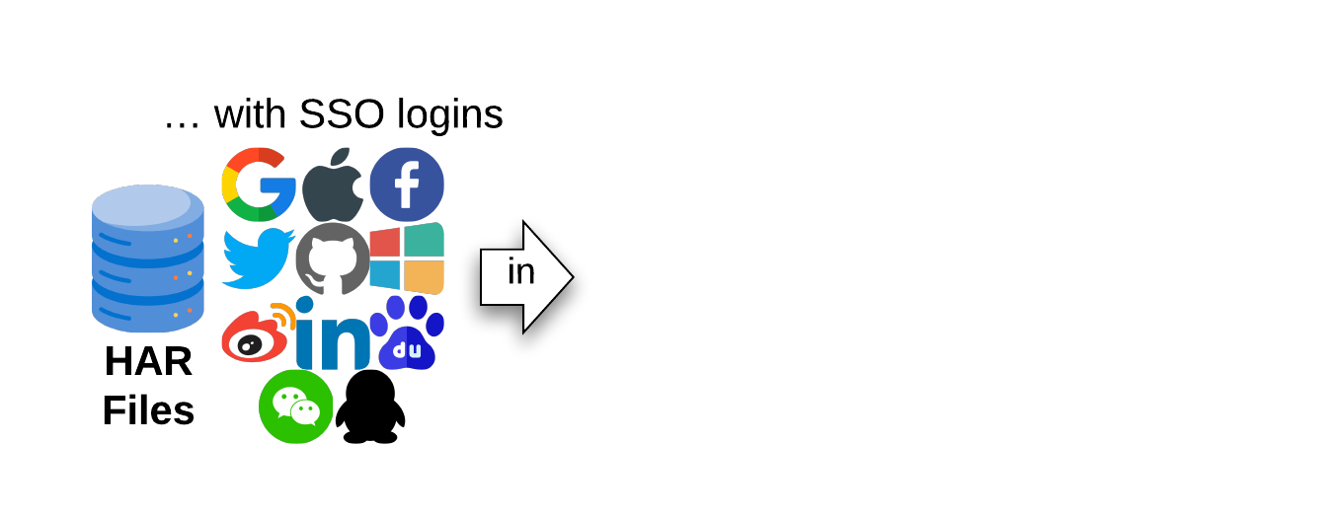
Methodology
Identity Brokers Systematization
SP relation:
First-party or Third-parties
Audience:
Public or Internal

Slide 8
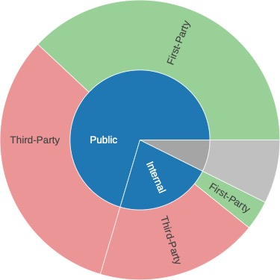
“redirect_uri” validation
The redirect_uri validation change based on the Identity broker integration
Third-party Identity brokers will implement a traditional redirect mechanism
First-party Identity brokers will implement a client-side redirect mechanism
Manually tested all 249 Identity brokers, injecting either XSS attack or testing the validation procedure against covert redirect attacks
49 Identity brokers with vulnerable redirect_uri validation procedure
(48 IdBs with Open-redirect and 7 XSS) → 2421 affected SPs
34/36 IdB confirmed token leaks → Account takeover on 1950 SPs

Slide 9




Brokered SSO Flow Major Problems:
One Consent for 4 Actors
Client ID Reuse
Login Request / Response Confusion
OAuth Best Current Practice violation

Slide 10
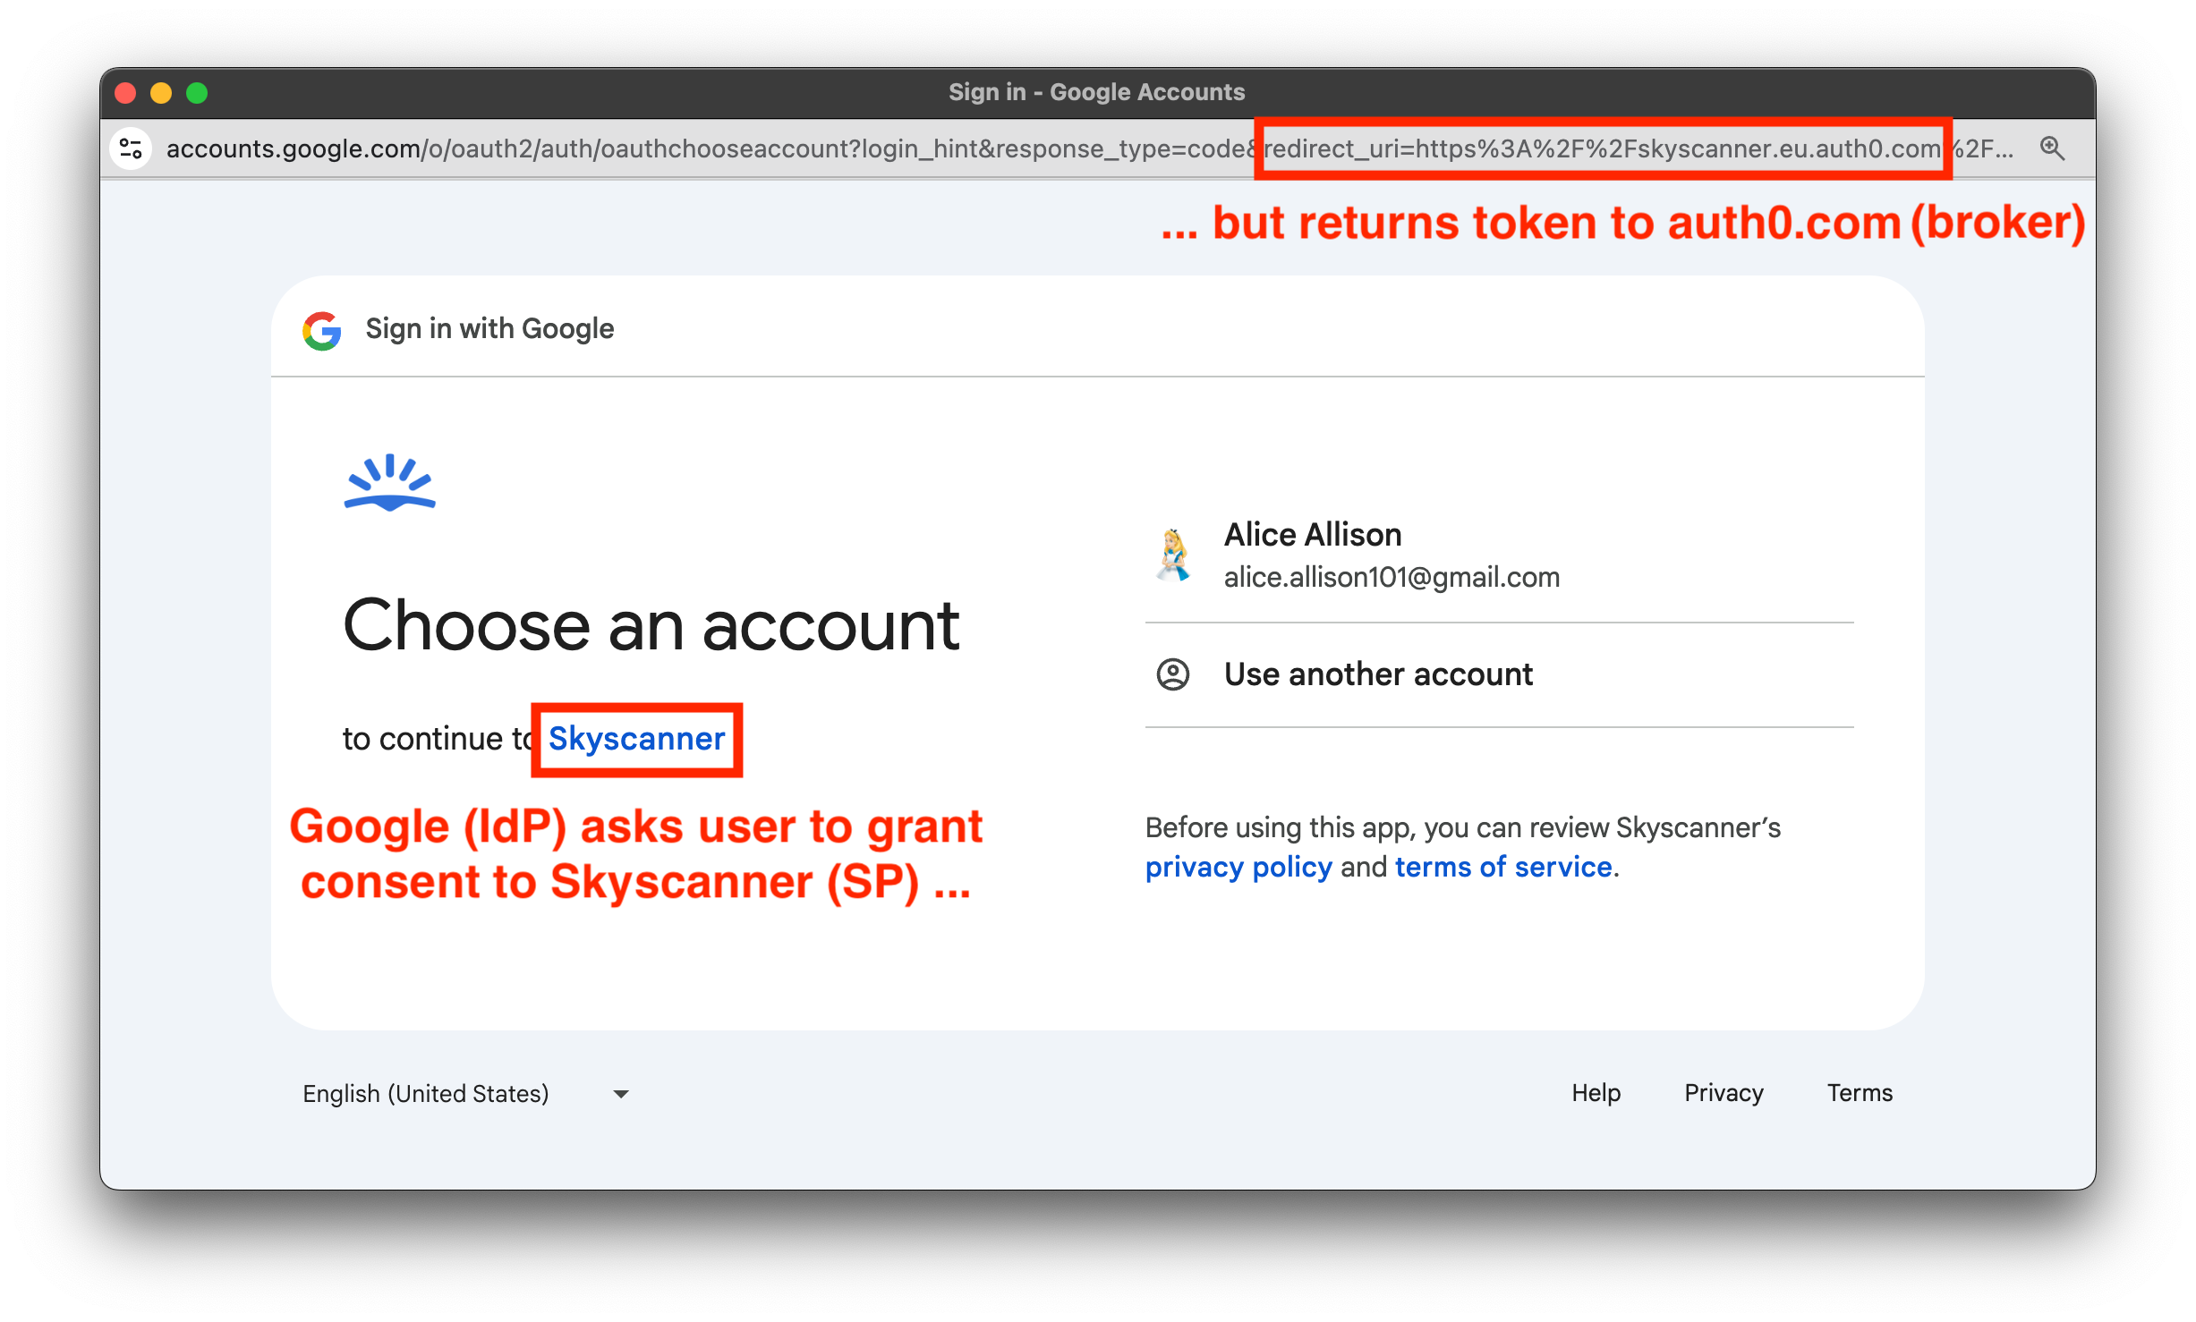
One Consent for 4 Actors
Two logically chained OAuth flows
but only one consent prompt
Two consent prompts introduce
friction in the login flow and can
confuse the users
All consent prompts in Brokered
SSO hides the presence of the Identity Broker

Slide 11
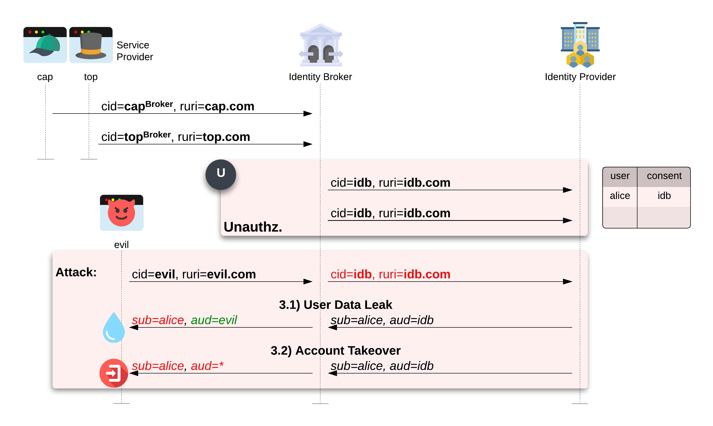
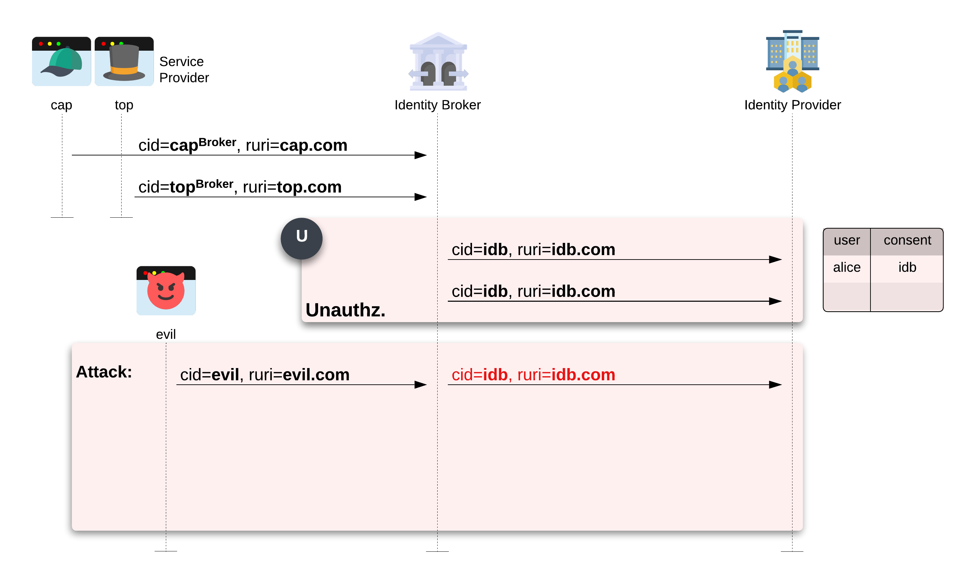
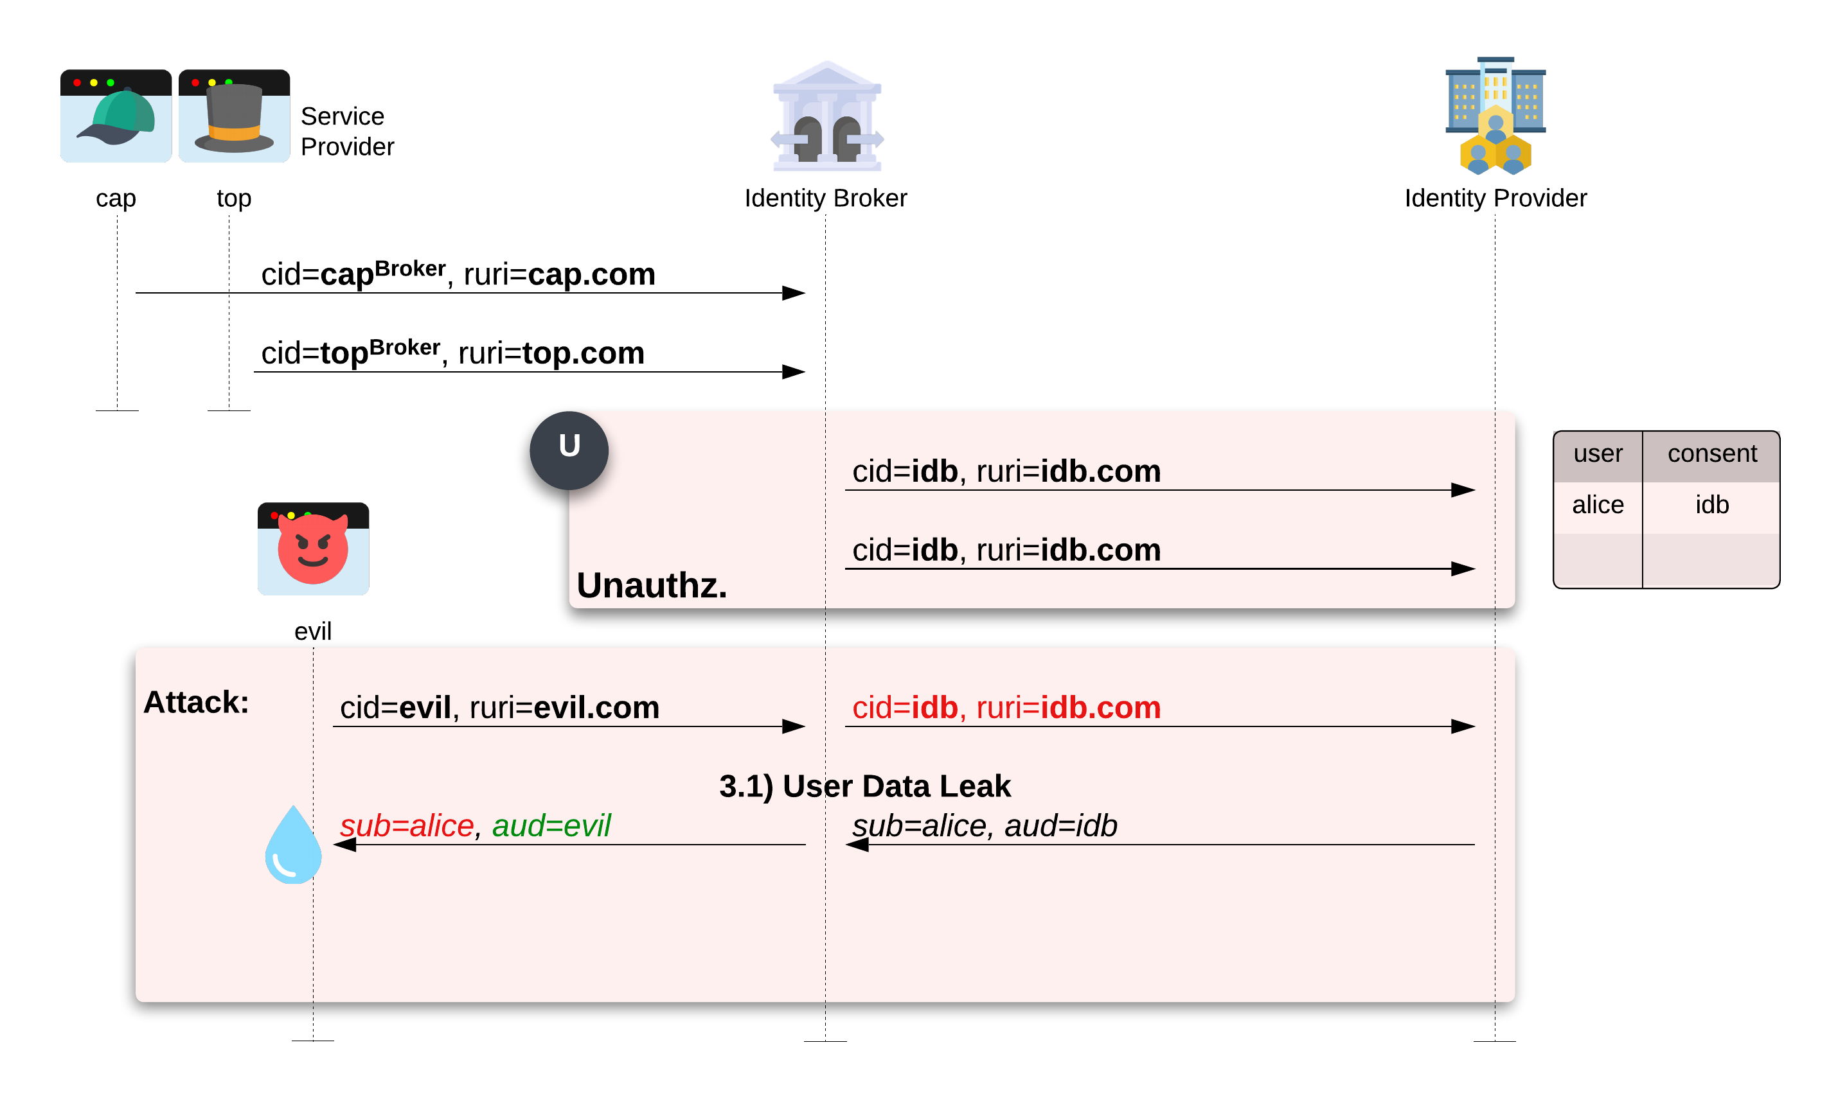
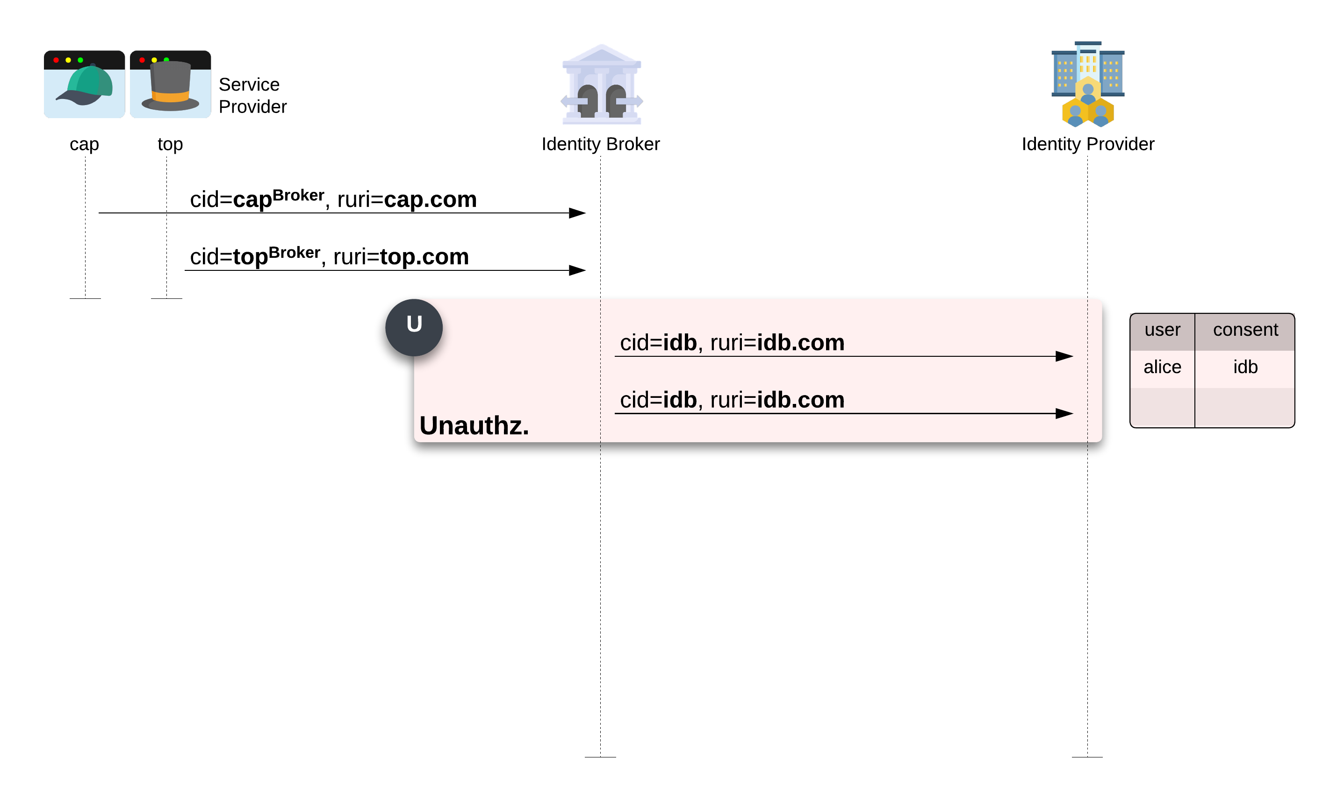
Client ID Reuse
Identity brokers only use one
Client ID for all SPs
User’s information Leak
Account Takeover
15 Identity Brokers vulnerable to
user’s information leak
6 Identity Brokers issued unscoped
authorization token

Slide 12
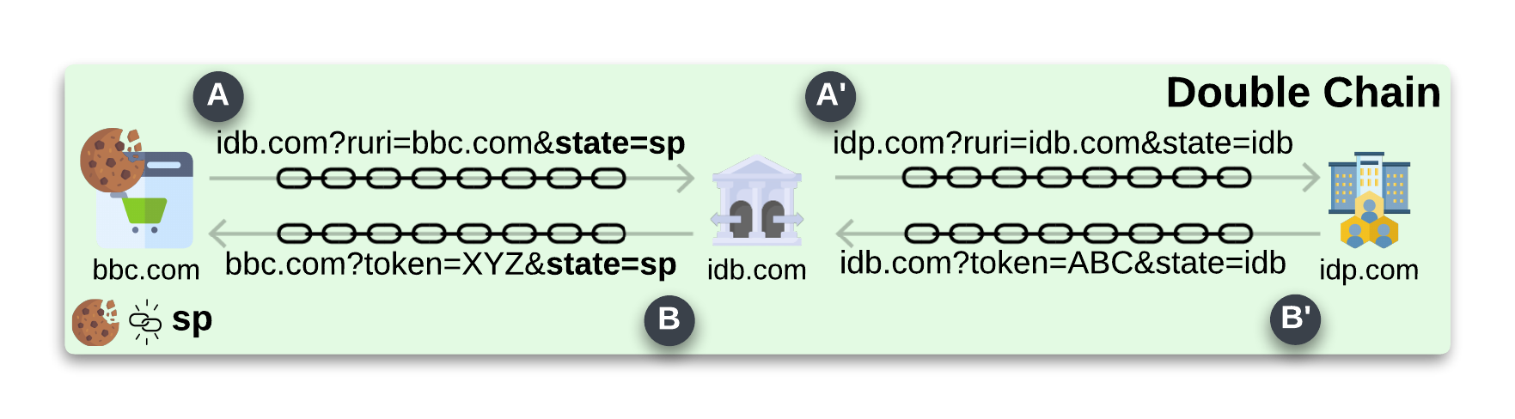
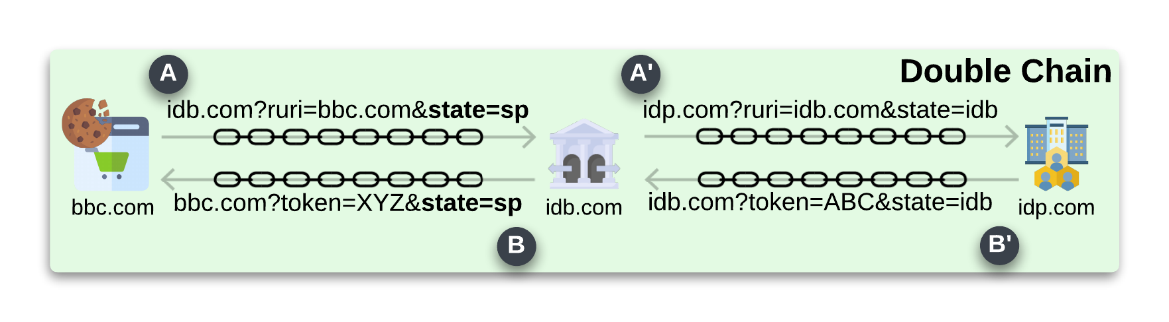
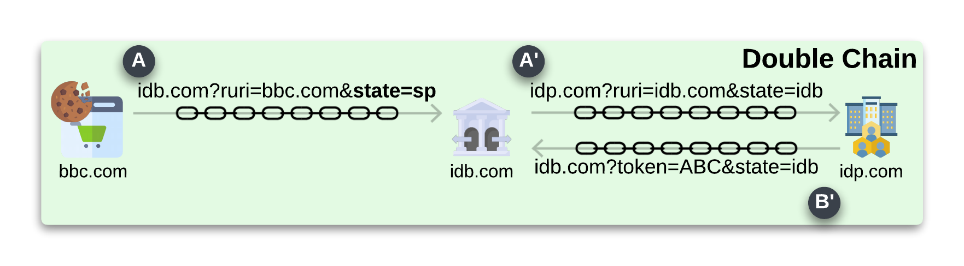
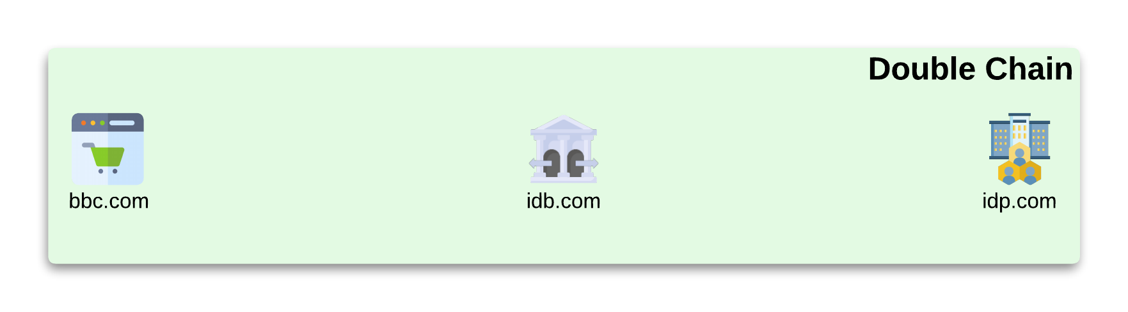
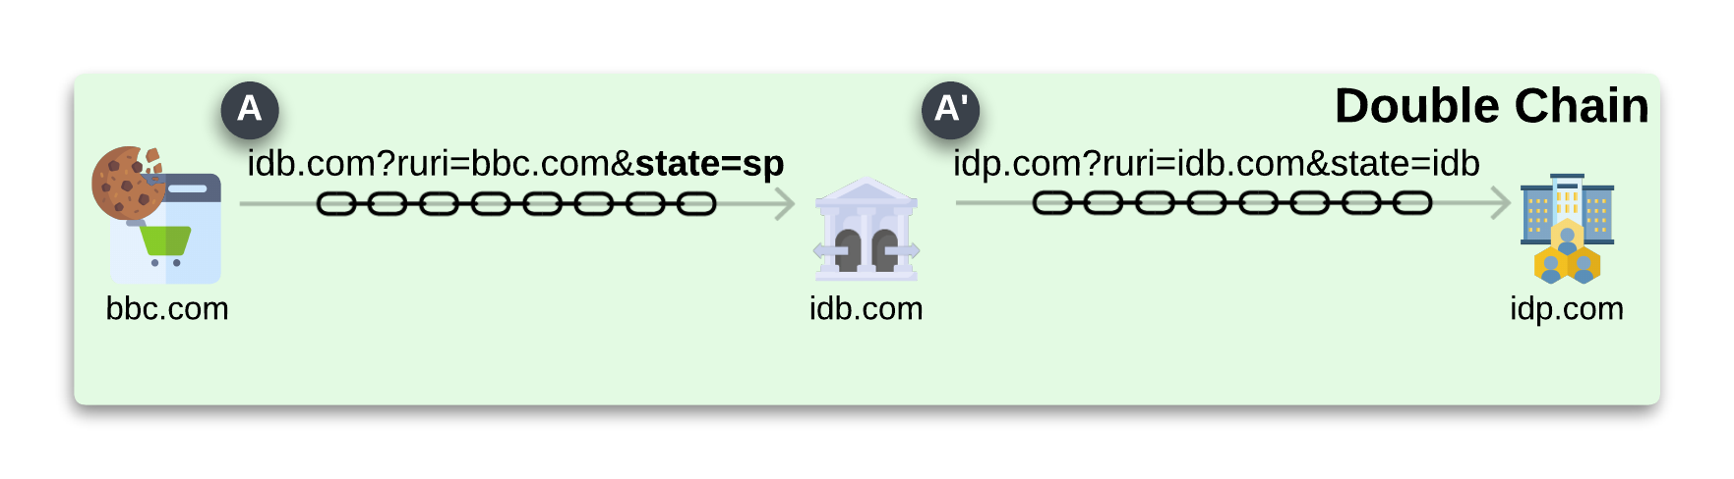
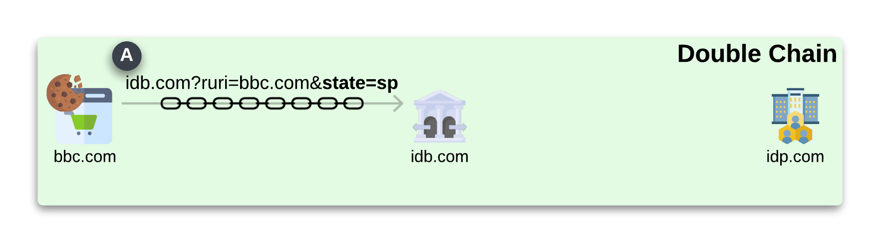
Correct chain scheme Brokered SSO
The double chain scheme allows
a correct implementation of the Brokered SSO

Slide 13
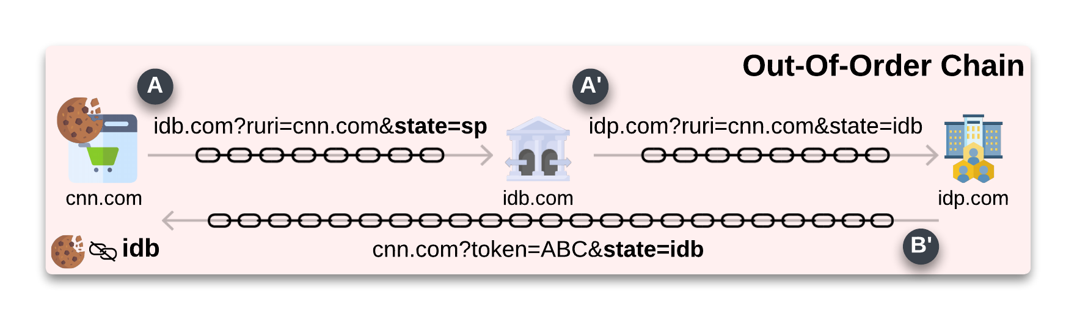
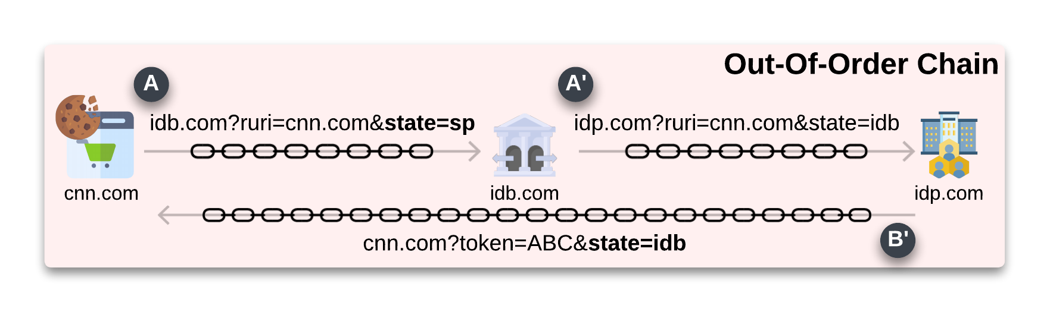
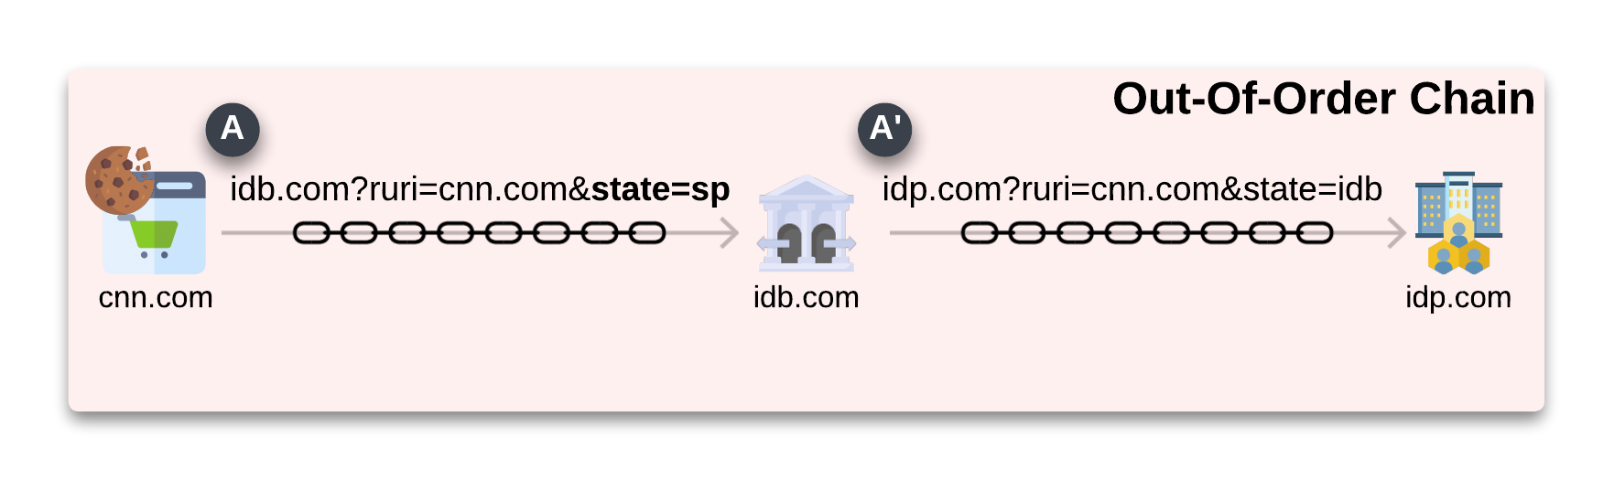
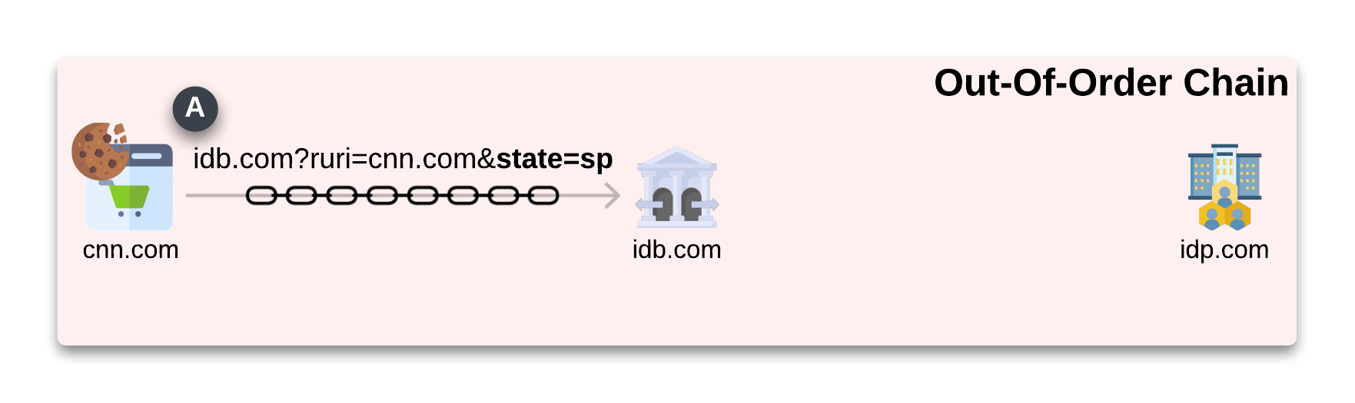
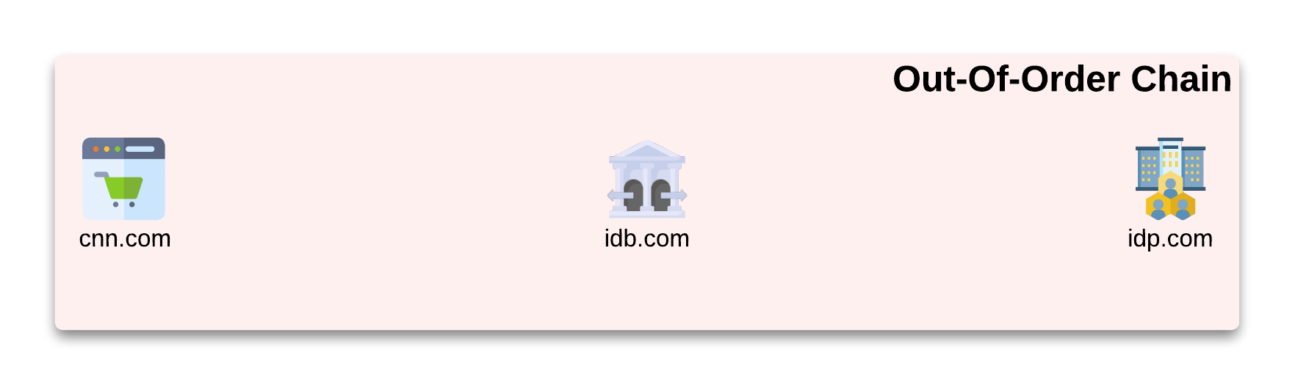
Login Request / Response Confusion
Out-Of-Order chain scheme
blocks the correct parameter validation, exposing the login flow to the LoginCSRF attack
69 Brokered SSO flows used the
Out-Of-Order chain scheme

Slide 14
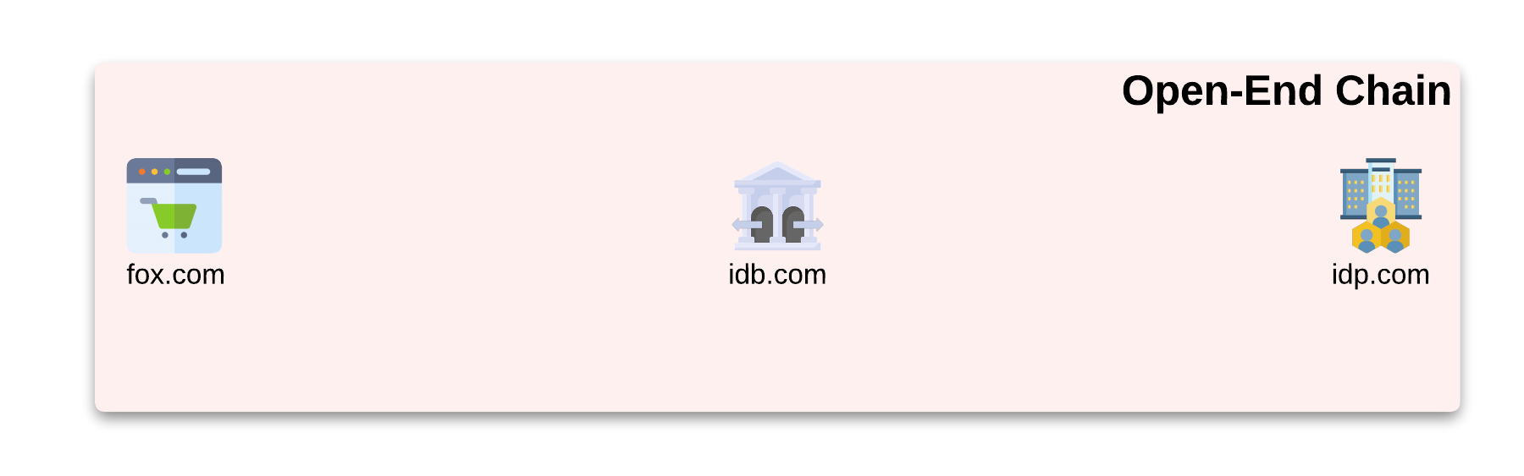
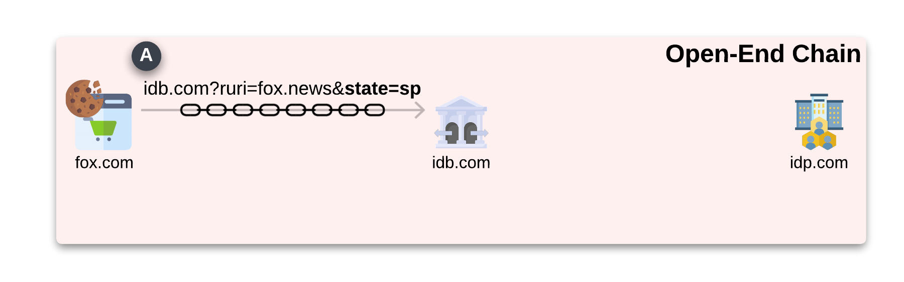
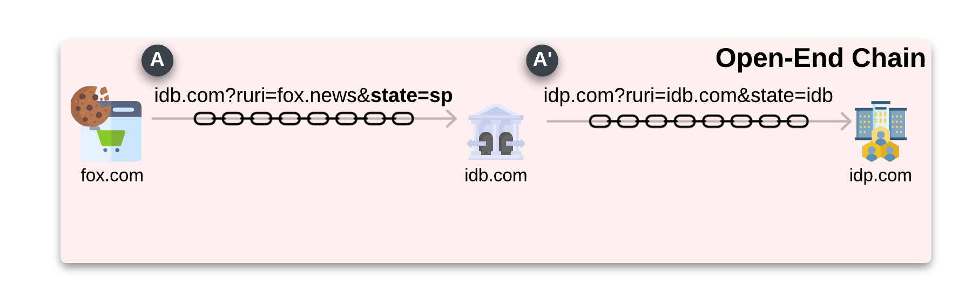
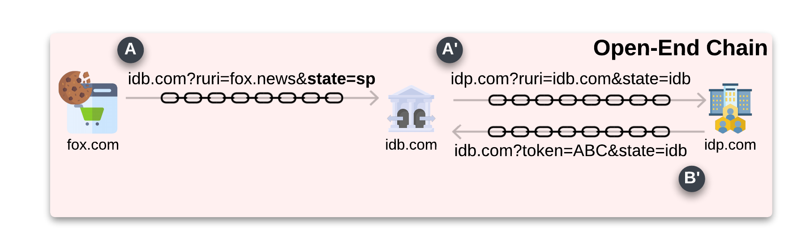
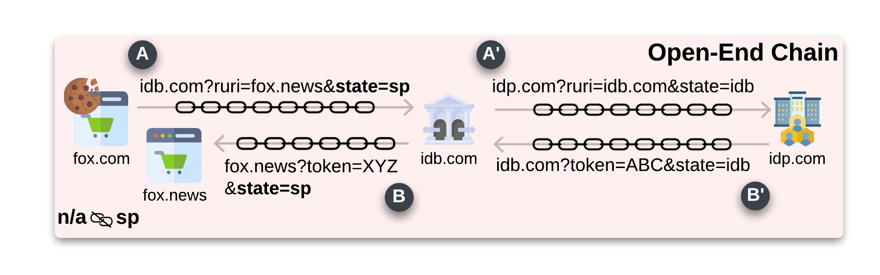
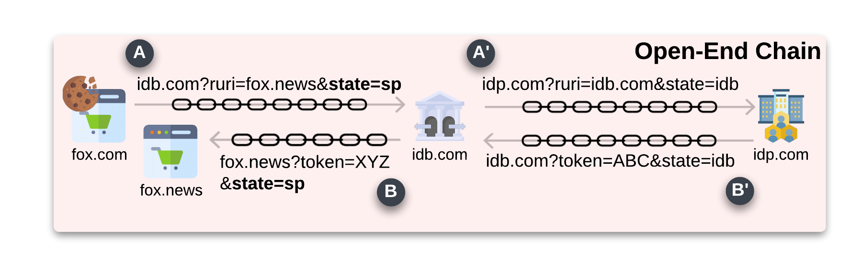
Login Request / Response Confusion
Open-End chain scheme
blocks the correct parameter validation, exposing the login flow to the LoginCSRF attack
57 Brokered SSO flows used the
Open-End chain scheme

Slide 15
Best Current Practice
1,872 violations on 2,780 websites
Identity brokers remove PKCE, exposing
brokered SSO to LoginCSRF and token leak
Identity Brokers actively downgrade the security of the login flow.

Slide 16
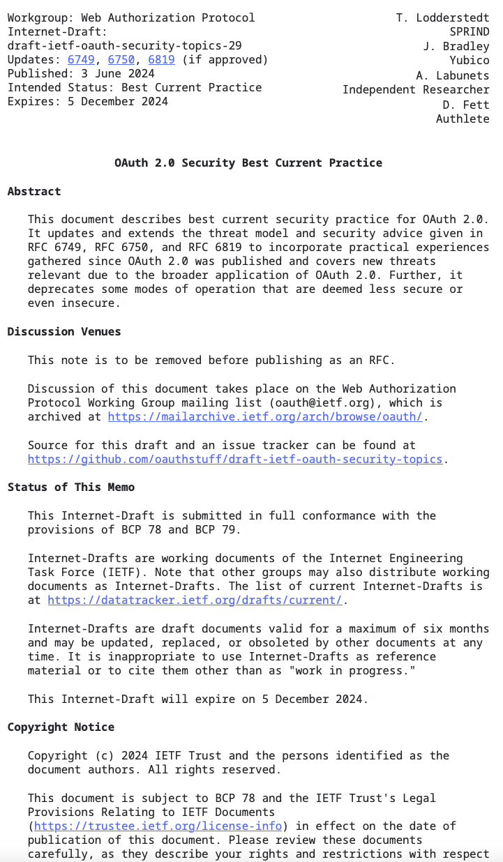
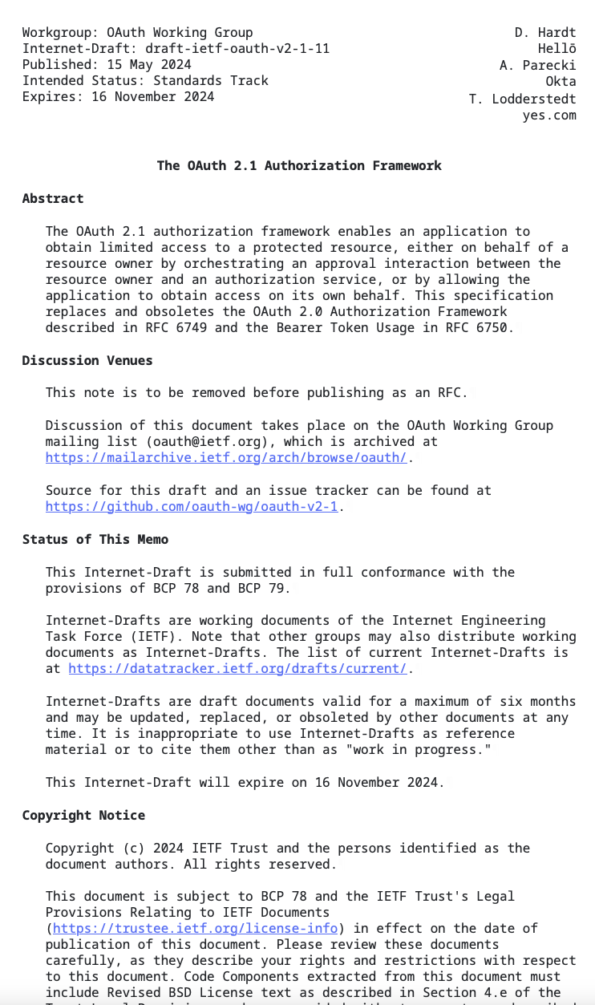
Improving the OAuth 2.1 and OAuth Security Best Current Practices
can mitigate the presented issues
The consent page in the presence of Identity Brokers should inform the user of this intermediary actor in the login flow
Introduce the requirement of using separate Client_ID for each Service Provider when the intermediary (Identity Brokers) obtains a Client_ID from an Identity provider.
A specification extension can confidently outline the correct implementation of Brokered SSO.

Slide 17

Thanks for your attention.
Our research artifacts:
https://zenodo.org/records/13918427

